Slide 1
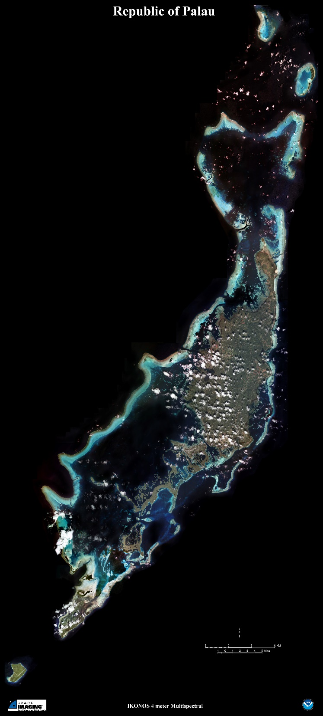
CLIMATE CHANGE & PALAU
Presentation Developed by:
Coral Reef Research Foundation
Funded by:
New Zealand North Pacific Development Fund
© 2022 Coral Reef Research Foundation

Slide 2
Objectives
Rengalk er a skuul a mo ousbech aikal keldei el tetelel omesuub el mo mesuub er a ngedechel a eanged:
Omes a olechotel a ngedechel a eanged
Omes a video el kirel a ngedechel a eanged me a Belau
Omesubel a acidification er a daob el okiu a pH
© 2022 Coral Reef Research Foundation
Notes:
Write clear objectives for teacher, using climate change video and pH for ocean acidification. And what is expected for students to learn.

Slide 3
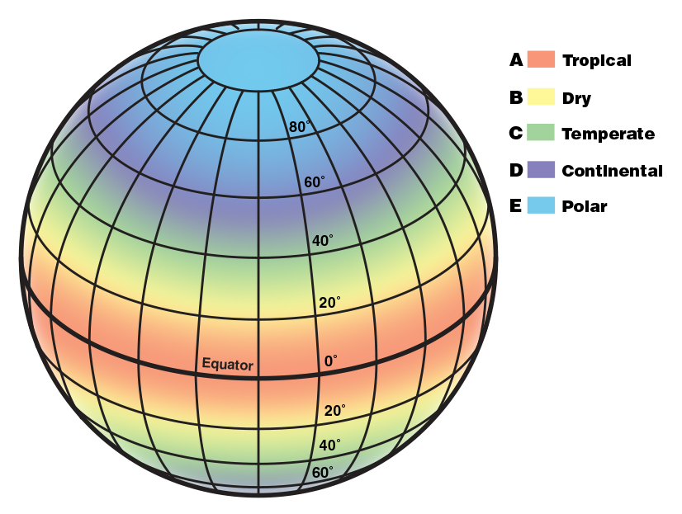
Ng ngera a Climate?
Kakerous el teletelel a eanged er a chimong el basio er a kma el kemangel el taem (okedei el rak me a lechub eng betok)
https://scijinks.gov/climate-zones/
© 2022 Coral Reef Research Foundation
Notes:
Climate is the average weather condition in a place over a long period of time (30 years or more). Places near the equator have a tropical climate, which is hot and humid. As you move further away from the equator, the climate becomes drier and colder.

Slide 4
Palau Tropical climate: Annual Averages
Humid: 74–87%
Hot: 28°C
Rain: 120–160 in
305–406 cm
Northeast Trade Winds: Oct-May
Southwest monsoon Winds: June–Oct
© 2022 Coral Reef Research Foundation
Notes:
Palau’s climate is a tropical climate, so it is hot and humid. We get a lot of rain, and there are two different seasons for wind: northeast trade winds and southwest monsoon winds.

Slide 5
Palau: Tropical climate
Belau a kmeed er a equator.
https://scijinks.gov/climate-zones/
© 2022 Coral Reef Research Foundation
Notes:
If you look back at this break up of climate regions, you should note that Palau is located near the equator. This is why we have a tropical climate.

Slide 6
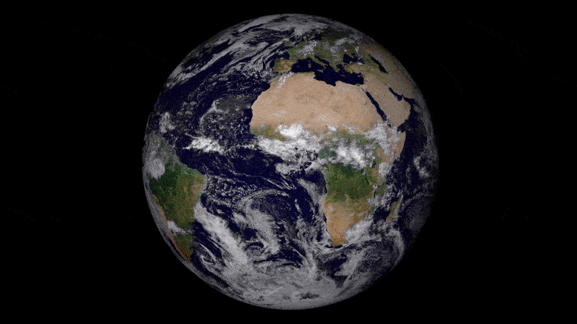
Teletelel a eanged er a Beluulechad a ultuil er a:
Sils
Daob
Atmosphere
Eabed
Kori
Chutem
Klengar
© 2022 Coral Reef Research Foundation
Notes:
Ng betok a uchul meng mo mengodech a teletelel a eanged er a beluulechad. Ng di mo ultuil er a sils, daob, metial atmosphere malechub eng eolt el melekedek er a Beluulechad, dirrek el kori ma chutem me a klengar er tiang el Beluulechad a mo ngodechii a teletelel a eanged. Aikakid a uchul meng sebched el mesang a ngedechel a eanged er a Beluulechad.

Slide 7
Ngedechel a Eanged
Tetelel a eanged el mla mengodech el lultuil er a kakaerous el teletelel a daob, chutem me a kori el ngii a duubech er a chelsel a kma el kemangel el taem (teruich el rak me a lechub eng kemangel).
Ng ochotii a kakerous ma mla mengodech el tetelel a eanged el uai a kelekolt, kleald me a chull er a chimong el basio el duubech er a kemangel el taem.
© 2022 Coral Reef Research Foundation
Notes:
What is climate change? Let 1 or 2 students answer, then give the definitions.
Climate change is a change in the pattern of weather, and related changes in oceans, land surface and ice sheets, occurring over time scales of decades or longer. It can also be defined as climate change describes a change in average conditions – such as temperature and rainfall – in a region over a long period of time.

Slide 8
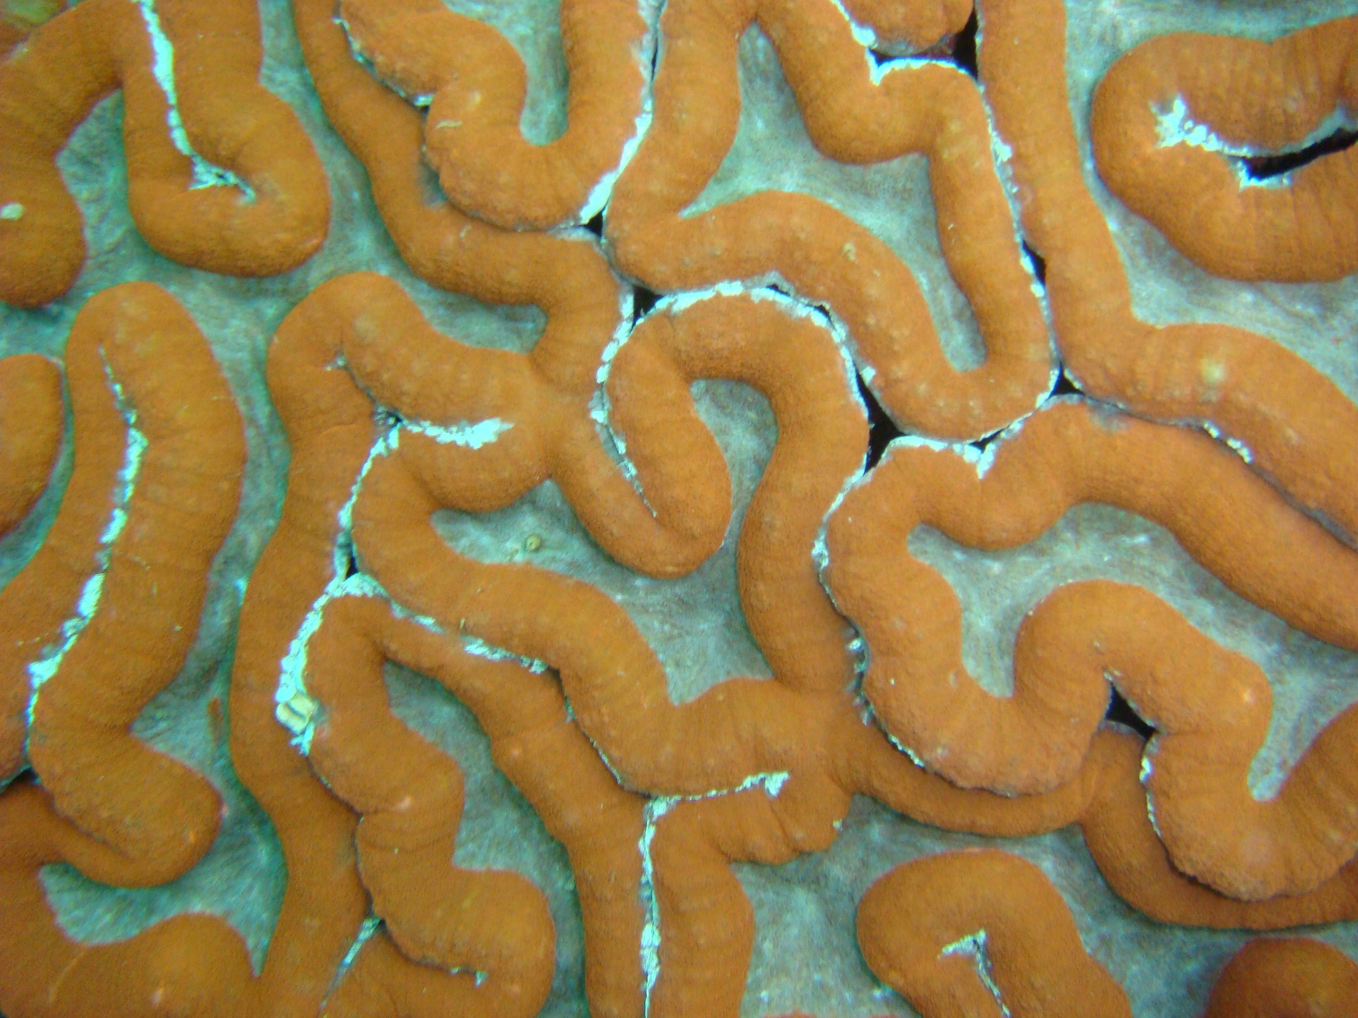
Kot el Omesuub: Olechotel a ngedechel a eanged er a chutem (lluich el mo er a okedei el bung)
© 2022 Coral Reef Research Foundation

Slide 9
Kot el Omesuub: Olechotel a ngedechel a eanged er a chutem (lluich el mo er a okedei el bung)
Rengalk er a skuul a mo omes a uchul a ngedechel a eanged er a beluu el ousbech aika el mla mekedmokl el babier el kirel tia el omesuub.
Omesodel
Mobii el mo er a kleuang el group.
A bek el group a morngii a babilengir el kirel tia el suobel (worksheet).
Momes e monguiu a babilengiu e bom lechesii a cherrungel el luldasu er a board.
Mocholt a komakai lomsodel a ngedechel a eanged.
Activity taken from: “The climate in our hands – Climate Change and Land, a teacher’s handbook for primary and secondary schools”, Office for Climate Education (OCE), Paris, 2022
© 2022 Coral Reef Research Foundation
Notes:
Students will have 15-20 minutes to review the worksheet and come up with a summary statement about the graphs. The statement should be specific with details of change.

Slide 10
Reading Graphs: Line graphs
For Worksheet A1.2, A1.4, A1.5, A1.7, A1.8
Ngera ngar er a x-axis me a ngera ngar er a y-axis (dechor el line)?
Y-Axis
X-Axis
© 2022 Coral Reef Research Foundation
Notes:
Go over how to read line graphs with students after passing out the activity 1 worksheet.

Slide 11
Reading Graphs: Line graphs
For Worksheet A1.2, A1.4, A1.5, A1.7, A1.8
A worksheet a ochotii el kmo a rak a ngar er a x-axis ea telkelel a kleald/kelekolt, telkelel a daob me a ngedechel a ildisir a rechad er a beluulechad a ngar er a y-axis.
Y-Axis
YEAR
2000
2005
2010
2020
© 2022 Coral Reef Research Foundation
Notes:
Different worksheets will have different variables on the y-axis. Students should identify which variable is plotted on the y-axis.

Slide 12
Reading Graphs: Line graphs
For Worksheet A1.2, A1.4, A1.5, A1.7, A1.8
Tia el line el ngar a graph a ochotii a kelekolt/kleald er a kakerous el taem.
32
31
Temperature
30
29
YEAR
2000
2005
2010
2020
© 2022 Coral Reef Research Foundation
Notes:
The line in the graph will show each variable changes through time. This example shows how temperature changes every year.

Slide 13
Reading Graphs: Line graphs
For Worksheet A1.2, A1.4, A1.5, A1.7, A1.8
Tia el olechotel a kelekolt/kleald a ochotii el kmo a kleald a ngilasech er a 3 degrees (kenguu a 32 el minus er ngii er a 29) er a chelsel a lluich el rak (2020-2000).
32
31
Temperature
30
29
YEAR
2000
2005
2010
2020
© 2022 Coral Reef Research Foundation
Notes:
More specifically, the example graph shows that temperature increased by 3 degrees in 20 years.

Slide 14
Get to work! (15-20minutes)
Momes er a graph em lechesii a cherrungel el luldasu (1-3 sentences) el kirel a oblam ues/suub.
Se el bomerek em saod el mo er a rengalk er a skuul.
© 2022 Coral Reef Research Foundation
Notes:
Have students look at their worksheet and come up with a statement of 1-3 sentences based on the graphs.

Slide 15
Worksheet A1.2: Climate Scientists
© 2022 Coral Reef Research Foundation
Notes:
This slide and the following slides can be used for students to present their statement. OR students can write their statement on the board. All groups should be copying the statements for the 1st page of the activity worksheet.
Some acceptable statements:
Temperature has increased by 2 degrees since 1880.
The Earth’s temperature is increasing. It was 16.5 degrees Celsius in 2020, about 2 degrees higher than the temperature in 1880.

Slide 16
Worksheet A1.4: Oceanographers
© 2022 Coral Reef Research Foundation
Notes:
Some acceptable statements:
1. Sea level has increased 240mm since 1880.
2. Sea level has increased by more than 200mm in the last 140 years.
3. Sea level is rising. In 2019 sea level was 200mm higher than in 1880.

Slide 17
Worksheet A1.5: Farmers
© 2022 Coral Reef Research Foundation
Notes:
Example statements:
There is a rise in the number of people experiencing drought. 200% increase in world population experienced drought in 2017.
More people are experiencing drought compared to 1960. Close to 200% more people experience drought since 1960.

Slide 18
Worksheet A1.6: Glaciologists
© 2022 Coral Reef Research Foundation
Notes:
Example statements
Since 1912, Kilimanjaro glaciers have melted away. 80% of the ice has melted in 88 years.
The glacier on Kilimanjaro is getting smaller. Only 20%, or 2.2 sq. km, of the glacier is left.

Slide 19
Worksheet A1.7: Tornado Chasers
© 2022 Coral Reef Research Foundation
Notes:
Sample statements:
Extreme weather events have increased/risen since 1900. There were over 120 events in recent times.
Since 1900, extreme weather events are more frequent. Since 2000, 80-120 extreme weather events were recorded per year compared to close to zero events in 1900.

Slide 20
Worksheet A1.7: Botanists
© 2022 Coral Reef Research Foundation
Notes:
The y axis is the timing of when cherry blossoms bloom. Since 1400, the cherry blossoms are blooming earlier in the year from mid-April to early-April.

Slide 21
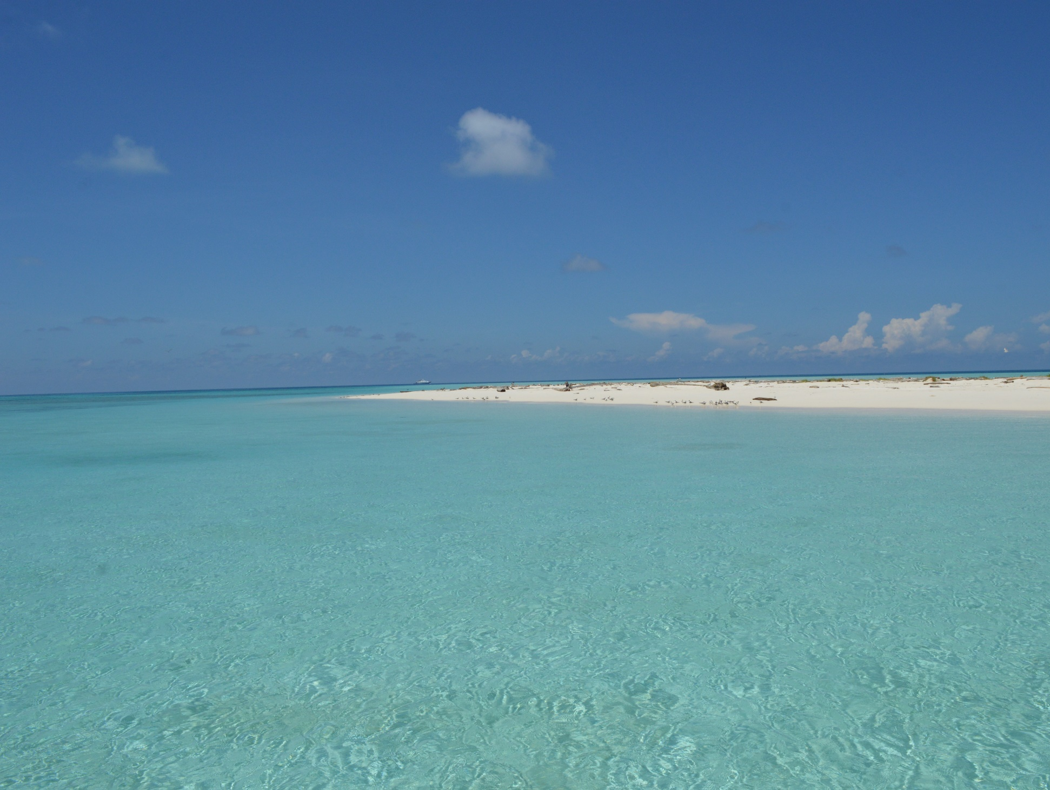
Wrap Up (5 minutes)
Ng kakerous a tetelel eanged er a bek el sils e dirrek el kakerous er a ika el mla mo merek el dart el rak: tia a domekedong er ngii el kmo climate change.
Kede mla mes e smaod a bebil er a mesisiich el olechotel e a tetelel a eanged a mla mengodech:
Kleald
Ngar er bab el dolech
Kemtimt
Toker el kori el ngar bebul a chutem
Mekdekudem el ieleb, mesisiich el eolt me a kemtimt
Mereched a temel a sim
© 2022 Coral Reef Research Foundation
Notes:
Spend a brief time to make a statement about these evidence of climate change.

Slide 22
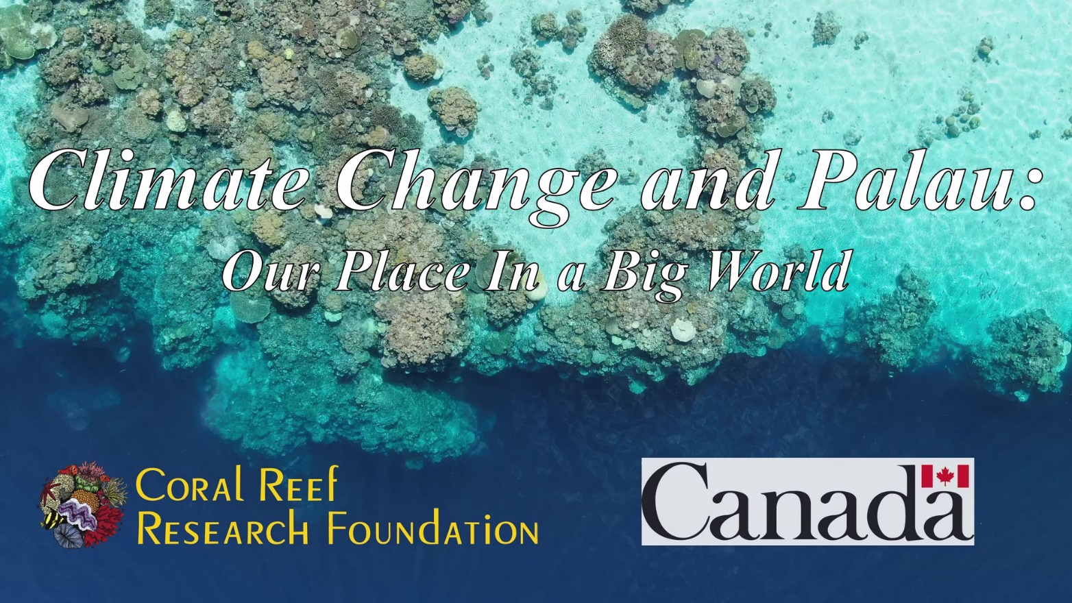
Activity 2: Climate Change & Palau
“Ngedechel a Eanged me a Belau– Basio er kid er a chelsel a Beluulechad”
Teruich me a tang el bung el video el kirel a ngedechel a eanged me a telemellel er a Belau. https://youtu.be/wpUsY6DJyOM
© 2022 Coral Reef Research Foundation
Notes:
To explore climate change and its impact, let’s looks at this video.

Slide 23
Activity 2: Climate Change & Palau
Key points:
Ngera telemellel a climate change?
Ngera telemellel a climate change er a beluulechad?
Ngera el telemellel a sebched el mes er a chelsel Belau?
Mousbech er a video el onger a ker el ngar er a Activity 2 Worksheet
© 2022 Coral Reef Research Foundation
Notes:
When watching this video, think about these key points. What is causing climate change, how is climate change affecting the world, and what kind of impact can we see in Palau. Students should use Activity 2 worksheet while watching the video. Answer key to worksheet is in the teacher’s guide.

Slide 24
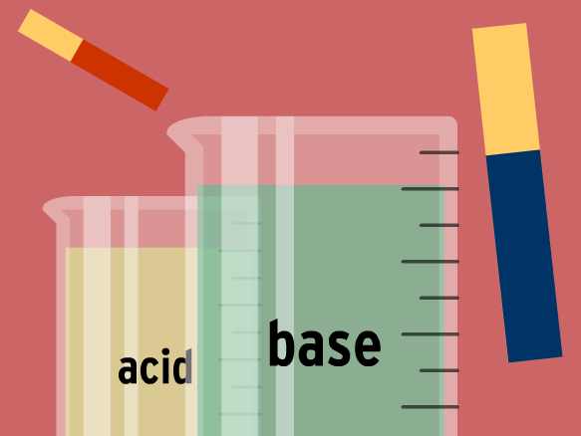
Activity 3: Ocean Acidification
Objective
Rengalek er a skuul a mo mesuub er a acidification er a daob el omuchel er a komakai lomsodel a pH. A ikakid a meklou a ultutelel el nger el mo sebechir el onger er a uriul er tia el telengtengil a omesuub.
Ngerang a pH?
Ngera belkul a acidic?
Ngera belkul a basic?
A ulaoch ngolecholt el
kmo a daob ng merael el
mo acidic? Me a lechub
eng basic?
© 2022 Coral Reef Research Foundation
Notes:
Ocean acidification can be in another class period. It will take 1 class period to complete this.

Slide 25
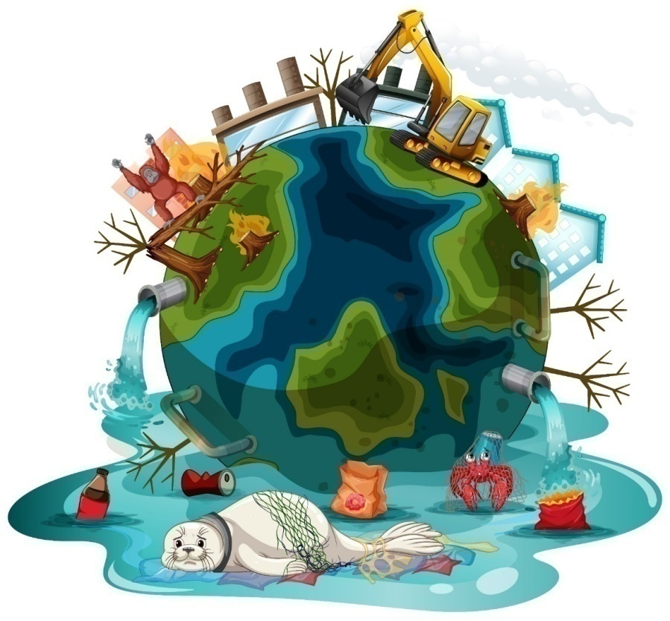
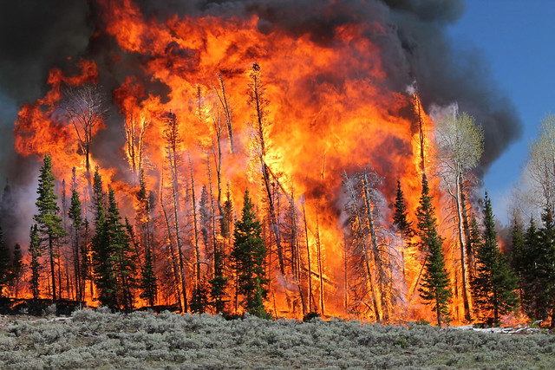
Ngera Ngodechii a tetelel a Eanged?
A rechad a kot el uchul a telemellel a eanged.
Eolt el rullii a greenhouse a dingii el duubech.
A rechad a meruul a betok er a ika el eolt el mo er a greenhouse.
Usbechellel a cheluch el mengai er a chutem.
Omelukouk a oreomel.
Image: Freepik.com
© 2022 Coral Reef Research Foundation
Notes:
Reminder: Humans are the #1 cause of climate change. While greenhouse gasses occur naturally, we produce a lot more of it through burning fossil fuels and cutting down or burning forests.

Slide 26
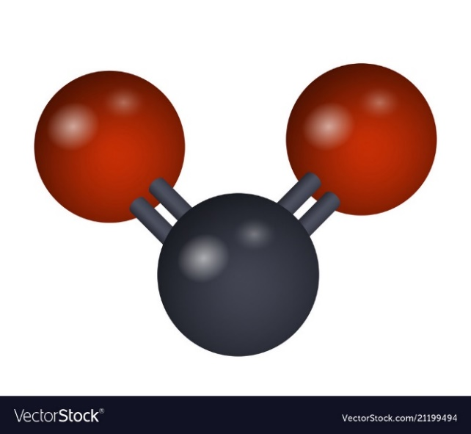
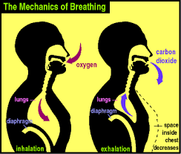
Recap: Eolt el loltobed a Greenhouse– Carbon Dioxide
O
O
C
A carbon dioxide me a lechub eng CO2 a dimla ngar er ngii er tia el beluulechad.
Kid a rechad se el douteliil ekede otungii a oxygen e oltobed er a carbon dioxide.
Dellomel a outeliil er a carbon dioxide e oltobed er a oxygen.
© 2022 Coral Reef Research Foundation
Notes:
Carbon dioxide is a natural gas in the world. Animals breathe in oxygen and exhale carbon dioxide. Plants take in carbon dioxide and produce oxygen.

Slide 27
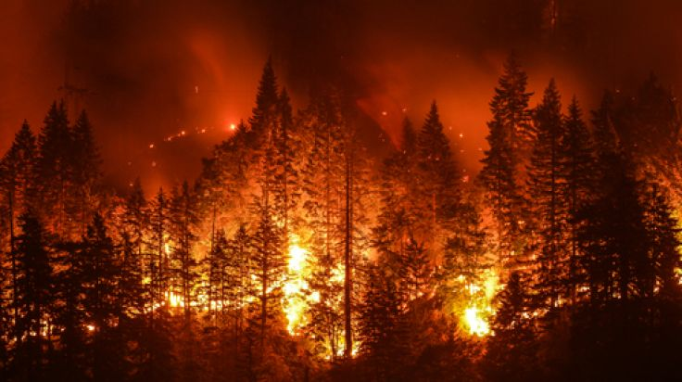
Recap: Eolt el loltobed a Greenhouse
A carbon dioxide a mokdubech e tuobed el mor er a eltel a beluulechad el okiu a usbechellel a cheluch er a roa mlai me a dirrek el omeleseb el oreomel.
Rak er a 2016, eng mlorngii a okeuang me a etiu el tonnes er a eolt er a greenhouse. E a klungel a carbon dioxide er tial cherrengelel a eolt a mla er bab er a okedei me a kleim el billion tonnes.
CO2: 35.7 BILLION TONNES
IN 2016
© 2022 Coral Reef Research Foundation
Notes:
But humans are producing too much greenhouse gases, especially carbon dioxide, by burning fossil fuels and forests. At 35.7 billion tonnes produced in 2016, carbon dioxide makes up the majority of the greenhouse gases emitted in the world.

Slide 28
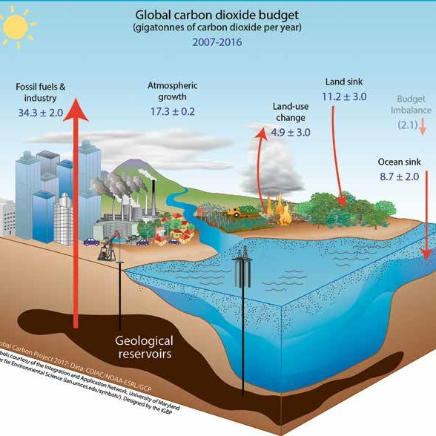
Me tia el CO2 ng mor er ker?
A tedobech er ngii a di ngar er a cheltel a melidiul er a beluulechad, e a tedobech er ngii a mo er a chutem e dirrek el soiiseb er a daob.
© 2022 Coral Reef Research Foundation
Notes:
What happens to all that carbon dioxide that our population has produced? Half of it stays in the atmosphere, while the rest ends up in the land and ocean. On land, forests will take up carbon dioxide. Remember, plants use carbon dioxide for photosynthesis.
The ocean will also absorb carbon dioxide. Since the start of the industrial revolution, the ocean has absorbed almost half of all the carbon emissions.

Slide 29
Me tia el CO2 ng mor er ker?
Klou el tedobech er a carbon a mla soiiseb er a daob er se er a lekot el omuchel morngii a meklou el kombalii ma siobai er a omeruul el klalou.
© 2022 Coral Reef Research Foundation
Notes:
What happens to all that carbon dioxide that our population has produced? Half of it stays in the atmosphere, while the rest ends up in the land and ocean. On land, forests will take up carbon dioxide. Remember, plants use carbon dioxide for photosynthesis.
The ocean will also absorb carbon dioxide. Since the start of the industrial revolution, the ocean has absorbed almost half of all the carbon emissions.

Slide 30
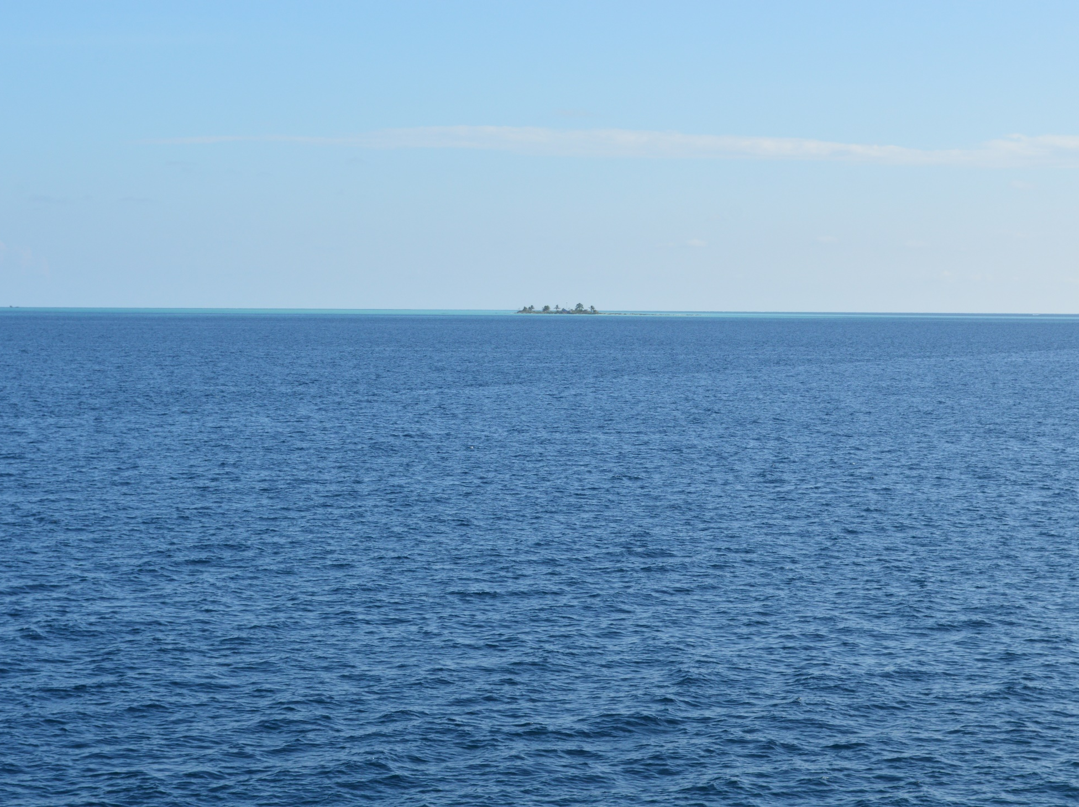
Ngera a Ocean Acidification?
A klou el carbon dioxide el soiiseb er a daob a rullii a daob me ng mo ngodech a teletelel e mo uchul meng mo mekngit er a dellomel me a charm el kiei er a daob.
© 2022 Coral Reef Research Foundation
Notes:
As the ocean absorbs more carbon dioxide, there is a change in its water properties that can be harmful to the plants and animals that live in the ocean. This is what is called ocean acidification.

Slide 31
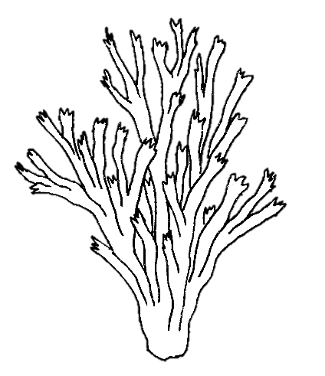
1.
Ocean Acidification
CO₂
4.
Mo mekesai a ngikel, tellemall el mo er a omenged me a rechad
CO₂
2.
H₂O
Carbonic Acid
pH
3.
Mechitechut me a lechub eng meliliut a kaiul. Mo mekngit a okurulel a chelemoll
Decrease carbonate
Increase H+
© 2022 Coral Reef Research Foundation
https://www.shapeoflife.org/resources/climate-change
Notes:
Power plants and cars release carbon dioxide into the air, and carbon dioxide ends up in the ocean.
Carbon dioxide combines with sea water and forms carbonic acid.
This process consumes carbonate in the ocean, which is a building block used to build skeletons of corals and sea shells. Carbonate decreases, and H+ or hydrogen ions increase.
pH decreases.
3. This leads to weaker coral skeletons and thinner shells, and the coral reef health declines.
4. This leads to a decline in fish, and fisheries and people who depend on fish will suffer.

Slide 32
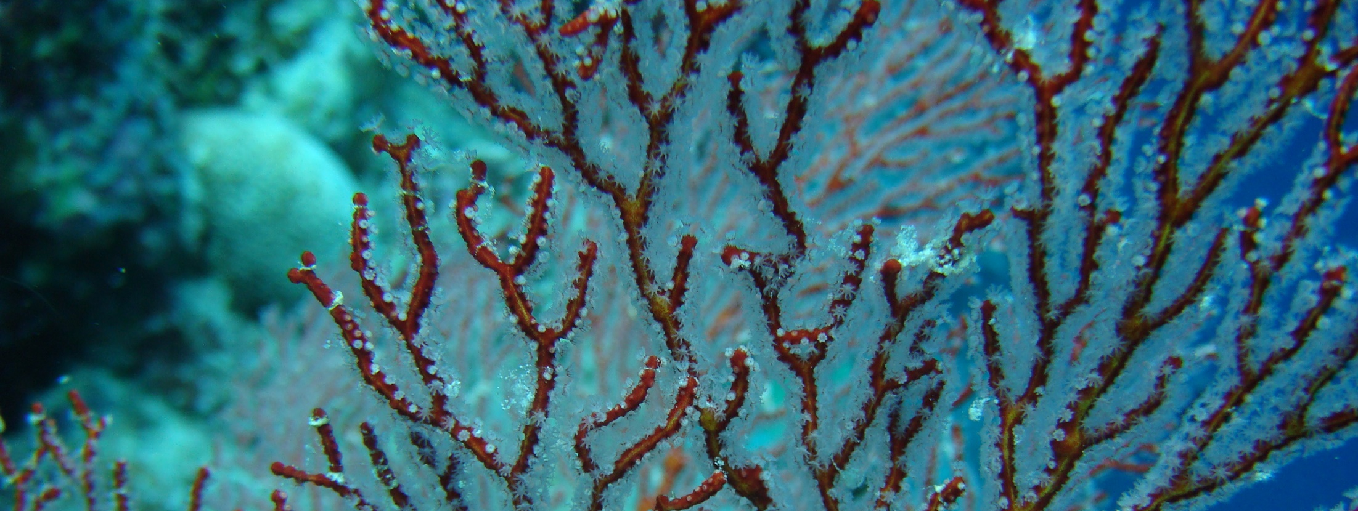
Ngera a Ocean Acidification?
Mese el lorael el mo klou a carbon dioxide er a eolt me a daob, eng ngar er a ulaoch el kmo a daob a mo acidic.
A pH scale a doba el meluk er a klungel a acid er a ralm el ochotii el kmo ng acidic me a lechub eng basic.
© 2022 Coral Reef Research Foundation
Notes:
As the ocean absorbs more and more carbon dioxide, it becomes acidic. But how do we know how acidic is ocean is and will become? We can measure the acidity of a substance, or how acidic or basic it is, using a pH scale.

Slide 33
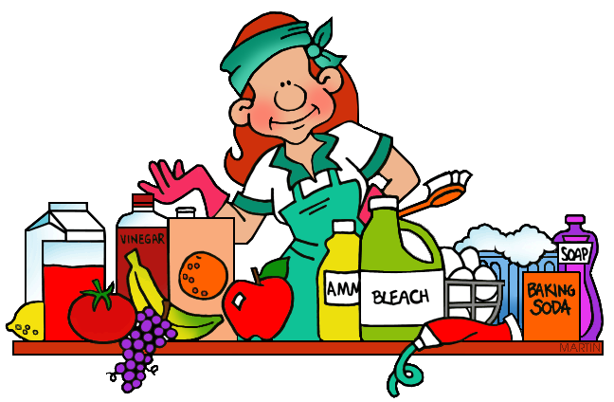
Ocean Acidification: What is pH?
Ng ngerang a pH?
Ng potential er a hydrogen.
Cheldellel a protons (H+, hydrogen ions) el ngar er a chelsel a solution.
Ke dousbech er ngii el merritel el kmo a ralm ng acidic me a lechub eng basic.
14
Basic or
Alkaline
7
Neutral
0
Acidic
© 2022 Coral Reef Research Foundation
Notes:
What is pH?
pH is the potential of hydrogen, or the concentration of protons in a solution. It measures how acidic or basic a solution is. pH is measured on a scale from 0 to 14. Solutions with a pH of 0-6 are acids, with 0 being the strongest acid. Solutions with a pH of 8-14 are bases with 14 being the strongest base. If a solution has a pH of 7, it is neutral. Distilled water has a pH of 7.

Slide 34
Ocean Acidification: What is pH?
A basic solution has a low H+ concentration, less than that of pure water (8-14 pH)
14
Basic or
Alkaline
Pure water, distilled water is neutral, pH 7
7
Neutral
An acidic solution has a high concentration of hydrogen ions (H+), greater than that of pure water, 0-7 pH
0
Acidic
© 2022 Coral Reef Research Foundation
Notes:
pH is measured on a scale from 0 to 14. Solutions with a pH of 0-7 are acids, with 0 being the strongest acid. Solutions with a pH of 7-14 are bases with 14 being the strongest base. If a liquid has a pH of 7, it is neutral. Distilled water has a pH of 7.

Slide 35
Ocean Acidification: pH levels
A daob ng alkaline me a lechub eng basic.
pH er a daob a mo merael el mer eou.
1751–1994
pH decrease 8.25 to 8.1
Current pH
8.1
2100 pH
7.67
© 2022 Coral Reef Research Foundation
Notes:
Uangera klungel a pH er a daob er elchang el taem?
Elechal time eng 8.1 a klungel a pH. Me ng alkaline me a lechub eng basic. Eng di a cherrengelel a klungel a pH er a beluulechad a mla merael el mor er eou el mla er a 8.25 e elechang mla mo 8.1 (1751-1994).
Ng uangera klungel el pH er a daob a mo merael el mer eou.
Ulaoch a uasei ng mo merael el lemuut el mor er eou el mo 7.67 er a rak er a 2100.

Slide 36
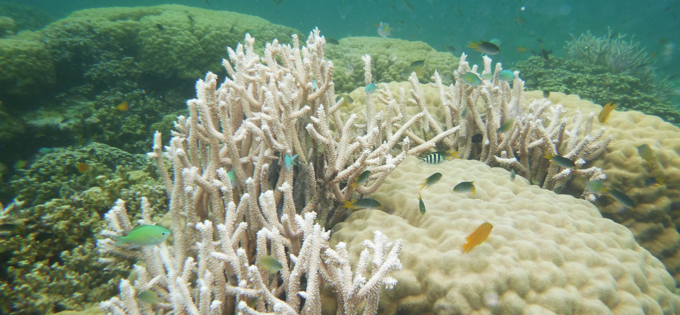
Ocean Acidification
Mekerang e ngodechii a daob?
Ocean acidification a sebchel ngodechii a okurulel a kaiul me a chiuesel a charm el uai a roa merangd, starfish, chesiuch me a bebil er a charm el kiei er a chelsel a kai.
© 2022 Coral Reef Research Foundation
Notes:
Why is this a problem? Well, as pH of the ocean decreases, the marine environment and the organisms living in these environment will be negatively affected. Animals that have shells or grow skeletons will not grow well, as their shells will be weak. Corals will grow more slowly and weaken coral reefs.

Slide 37
Ocean Acidification
Mekerang e ngodechii a daob?
Ng mo mechitechut a kaiul e diak lomekeroul.
© 2022 Coral Reef Research Foundation
Notes:
Why is this a problem? Well, as pH of the ocean decreases, the marine environment and the organisms living in these environment will be negatively affected. Animals that have shells or grow skeletons will not grow well, as their shells will be weak. Corals will grow more slowly and weaken coral reefs.

Slide 38
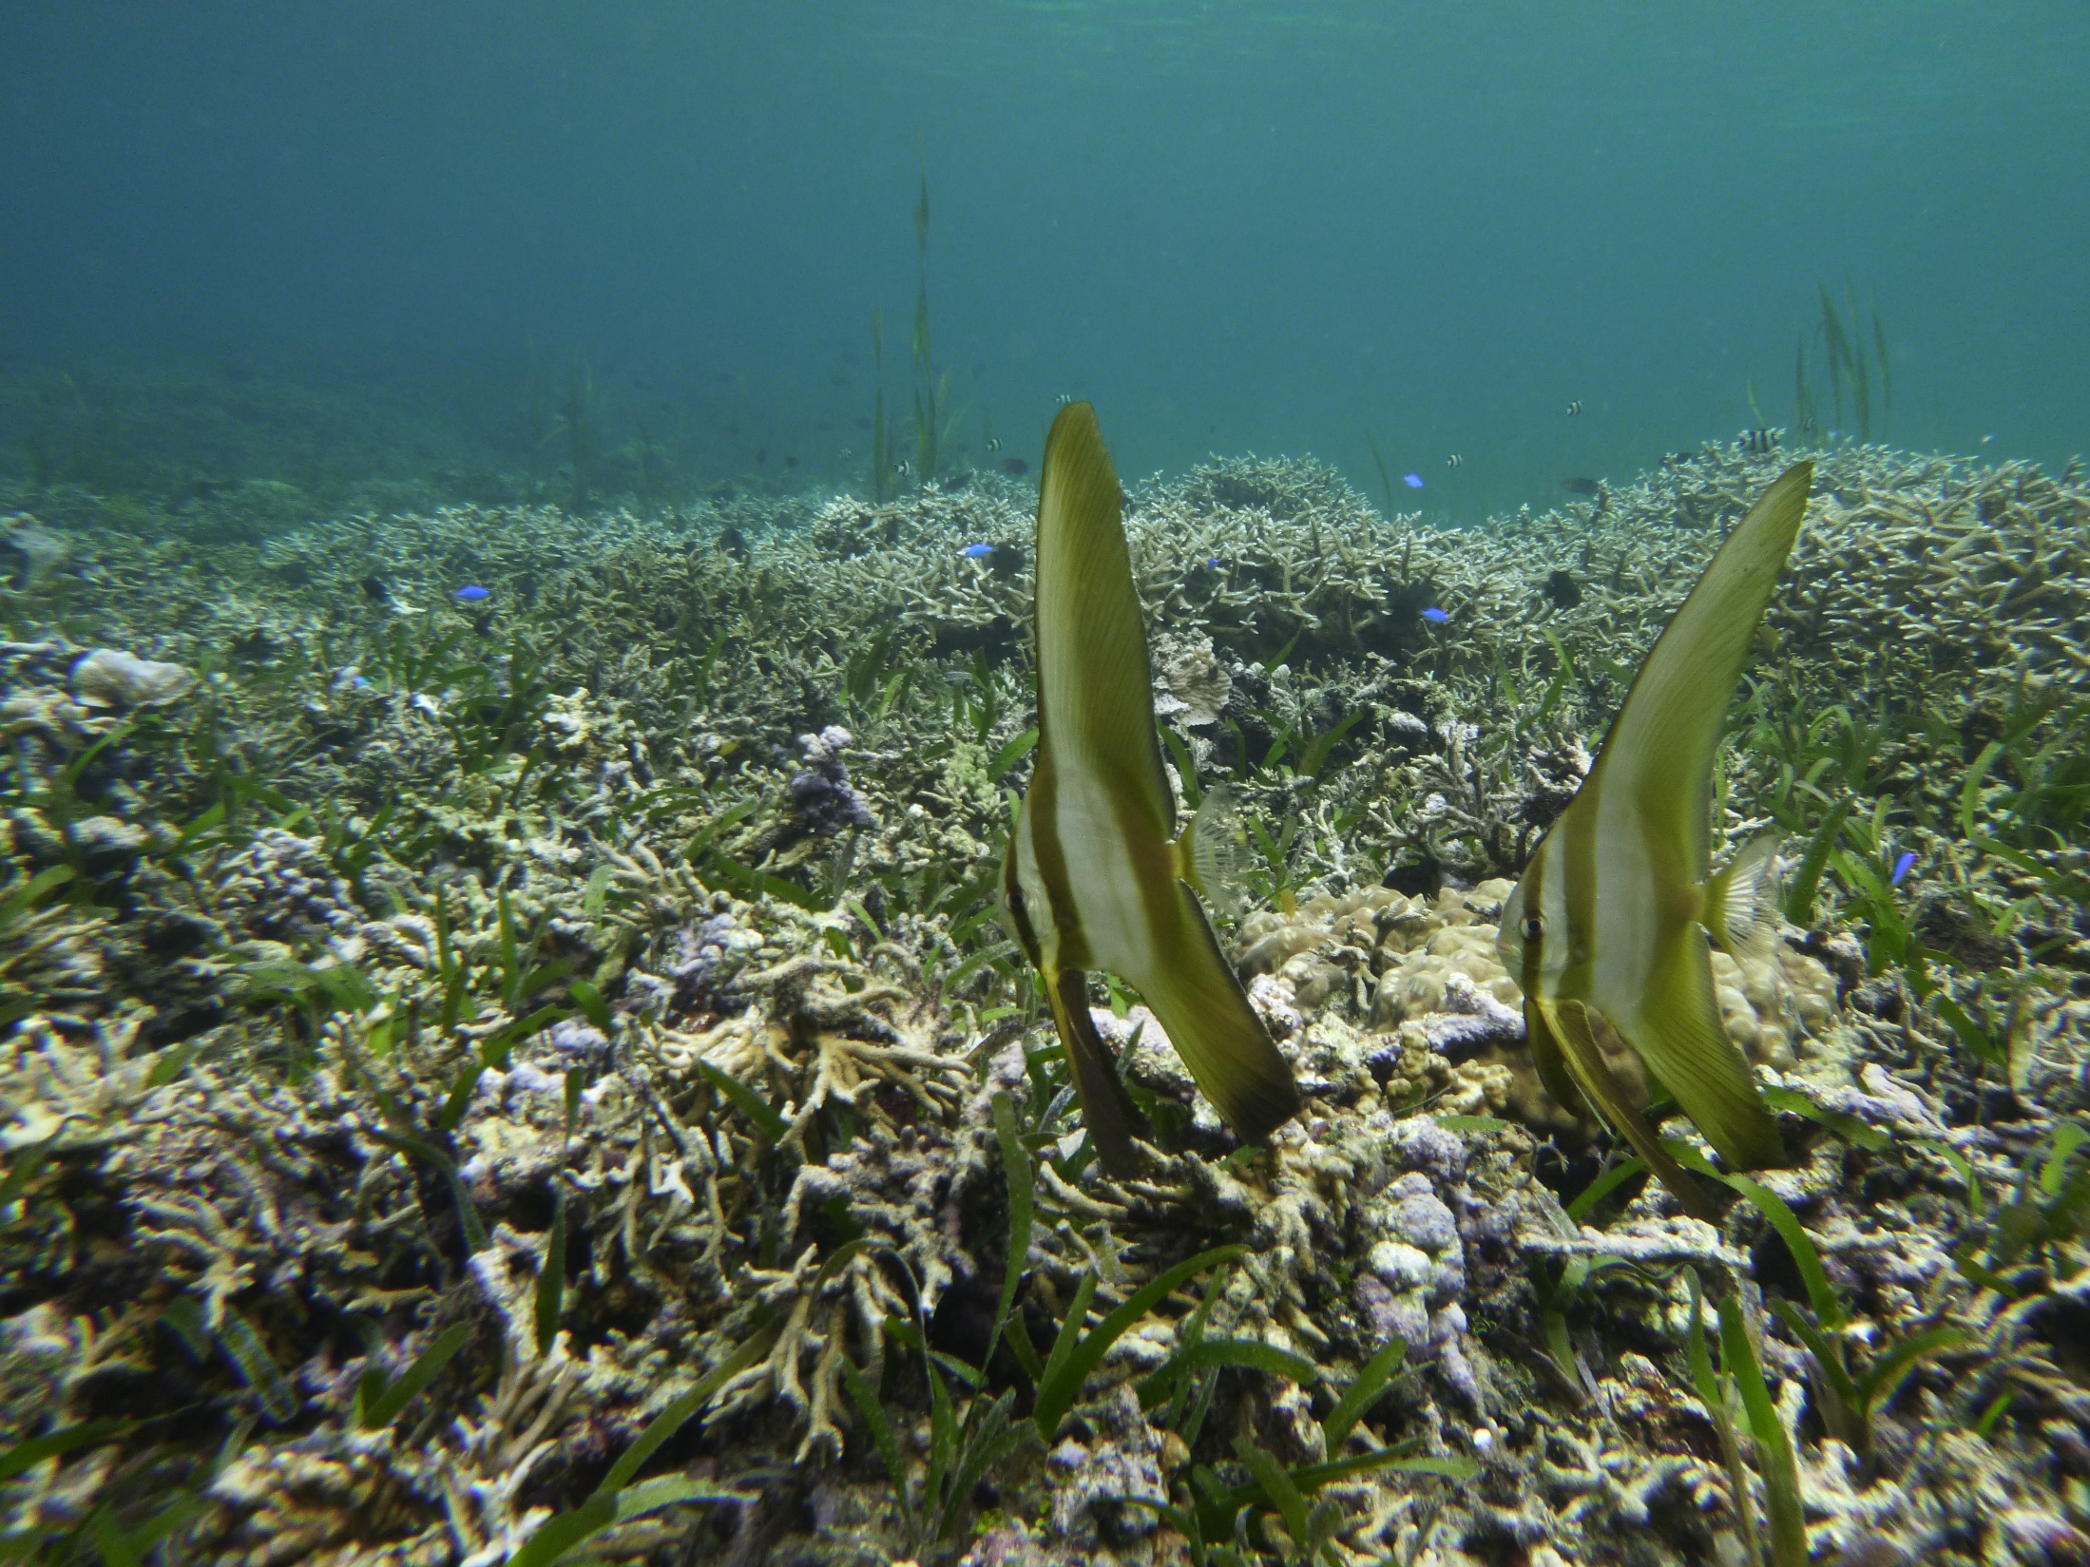
Mekerang e ngodechii a daob?
Merangd a mo meioud lomekeroul e mo mechitechut.
Ngikel el lultuil er a roa merangd a merael el mo mekesai.
© 2022 Coral Reef Research Foundation
Notes:
Why is this a problem? Well, as pH of the ocean decreases, the marine environment and the organisms living in these environment will be negatively affected. Animals that have shells or grow skeletons will not grow well, as their shells will be weak. Corals will grow more slowly and weaken coral reefs.

Slide 39
pH Experiment
14
13
12
11
10
9
8
7
6
5
4
3
2
1
0
Monguiu er a babilengir a rengalk er a skuul el mo ungil.
Moltirakl aika el olechotel a rellel el ngar er tiang.
Ka monger a ikel keldei el ker el ngar er a data form.
Bom charm em luches a ike el liquids el ngar a column A.
Mnguu a pH paper el mo test em lluches a klungel a pH ra column B.
Bo mlechesii a list “ngarbab me a lechub eng ngar er eou” el lultuil er a klungel a pH el ngar er a Column C.
High = pH 0-6
Low = pH 8-14
Neutral = pH 7
Base/Alkali
Neutral
Acid
© 2022 Coral Reef Research Foundation
Notes:
In today’s experiment, you will learn about pH, acidic and basic solutions. In front of you, you will have different liquids and a student data form. Read the student data form and follow the methods. Students should taste liquids, then list liquids from low acidity to high acidity in Column A. They will guess based on their taste – which has a high acidity and which has a low acidity. Then they will use the pH paper to measure the pH, and enter values in Column B. Finally in Column C, write high or low depending on the values entered in column B.
STOP here, until students finish the experiment, then move to next slide.

Slide 40
Experiment Discussion
14
13
12
11
10
9
8
7
6
5
4
3
2
1
0
Base/Alkali
Kam sodii a pH el loba uldesuem?
Ngera mle kot el acidic el solution?
Ngera mle basic el solution?
Ngera pH er a ralm? Ng acidic, basic me a lechub eng neutral?
Neutral
Acid
© 2022 Coral Reef Research Foundation
Notes:
Go through each question with the class. Have different groups answer different questions. Groups can compare the list and order, some maybe a little different.

Slide 41
Omesodel a Experiment
14
13
12
11
10
9
8
7
6
5
4
3
2
1
0
A ikel omulemlaoch eng mlo merang?
Olechotel a substances el ngar er a basic (low acidity) to acidic (high acidity):
Baking soda
Seawater
Tap Water
Antacid
Coffee
Milk
Soda Water
Coke
Vinegar
Lemon Juice
Base/Alkali
Neutral
Acid
© 2022 Coral Reef Research Foundation
Notes:
Go through each question with the class. Have different groups answer different questions. Groups can compare the list and order, some maybe a little different.

Slide 42
Connecting the Dots
Momdas er a Belau me a telemellel el okiu aika el beldukl er eou. E kuk ngera a mo telemellel el mor er kau?
Daob el di merael mor er bab a kleldelel
Dolech el di merael el mor er bab
Ocean acidification
Ka momdasu el kmo ngera sebechem el kudmeklii el kirel a terbengel a climate change?
© 2022 Coral Reef Research Foundation
Notes:
How will rising ocean temperatures, rising sea level and ocean acidification affect the marine environment and the organisms living in them. Also, think of solutions and how you can be part of the solution.
Spend about 5 minutes on this to gauge how much students learned through the 3 activities. This is a critical thinking exercise.

Slide 43
Extra Slides

Slide 44
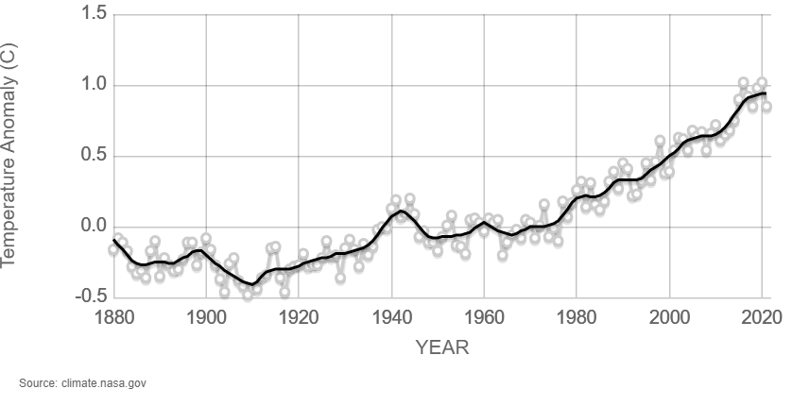
Telekelel a Kelekolt/Kleald er lomuchel er a 1880
© 2022 Coral Reef Research Foundation
Notes:
We first look at the temperature of land and ocean, and how temperature has changed since 1880. The further the point is away from the 0 mark on the Y axis, the warmer or colder each year is compared to the average temperature.

Slide 45
© 2022 Coral Reef Research Foundation
Notes:
So, how much have levels of carbon dioxide changed? Let’s look at the graph, and identify parts of it. This is a graph showing the changes in carbon dioxide levels in the last 800,000 years. 0 marks the year 1950. As you look at this graph, keep in mind that the first human civilization emerged only 5-6,000 years ago.
The level of carbon dioxide is measured as parts per million. What is parts per million? Think of it this way. If you have a level of 1 ppm that means for every million air molecules, 1 molecule would be carbon dioxide. If it is 320 ppm, for every million air molecules, you have 320 carbon dioxide molecules.
Scientists are able to estimate carbon dioxide levels by analyzing ice cores from glaciers. By analyzing ice cores from glaciers, they can see that carbon dioxide levels were previously around 200-280 ppm. There were years that carbon dioxide levels would fall a little below 200 ppm and rise to over 280 ppm. The highest concentration was about 350,000 years ago at 300 ppm. Then you get to 1950, which is marked by the 0, the carbon dioxide levels rose higher than 300 ppm. In 2020, they measured it at 412.5 ppm, an amount twice the level of what is normally found in the last 800,000 years, and this rise occurred in a short time.

Slide 46
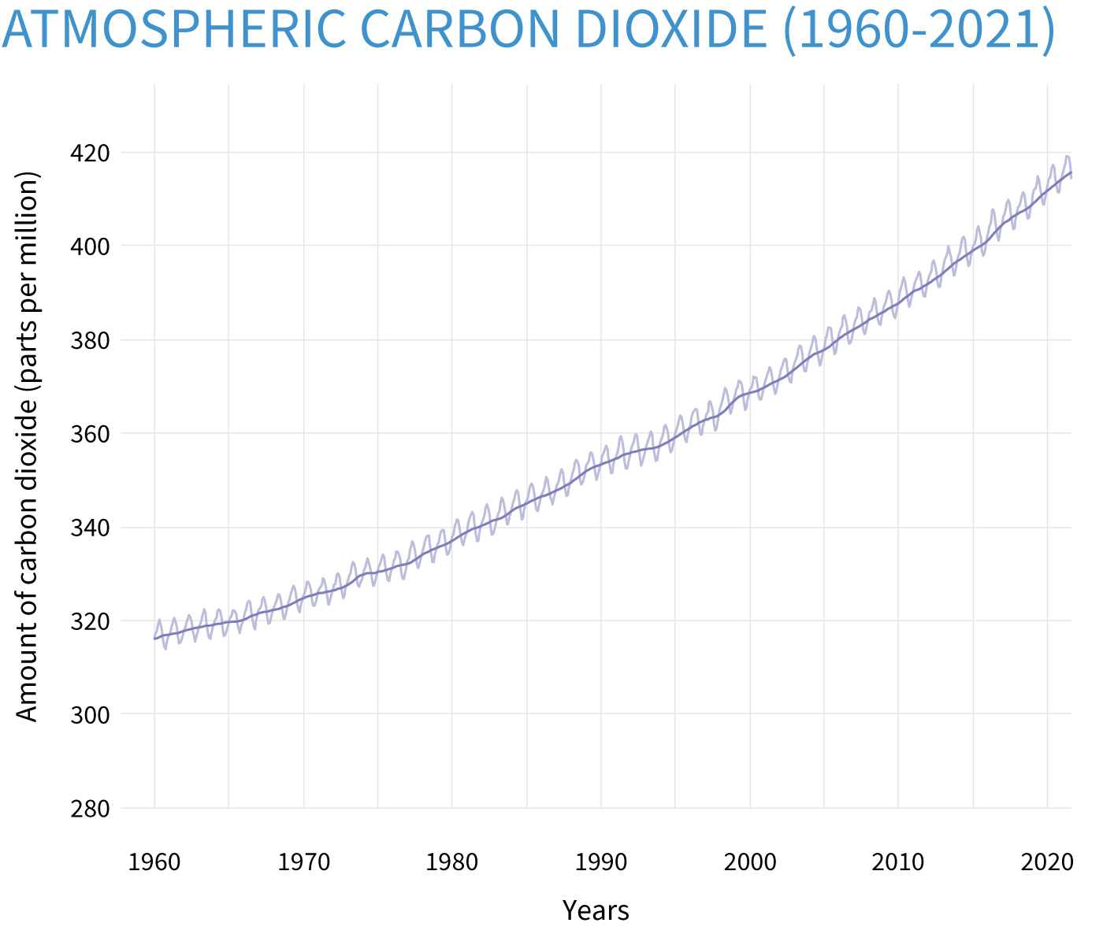
© 2022 Coral Reef Research Foundation
Notes:
If we look closer at that increase between 1950 and 2020, we can see how carbon dioxide levels increased. During this time, scientists measured the amount of carbon dioxide on a mountain in Hawaii. What they found was that carbon dioxide levels increased by 100 ppm in only 70 years.

