Slide 1
Weather & Climate in Palau
Developed by
Funded by
Angaur
©2022 Coral Reef Research Foundation

Slide 2
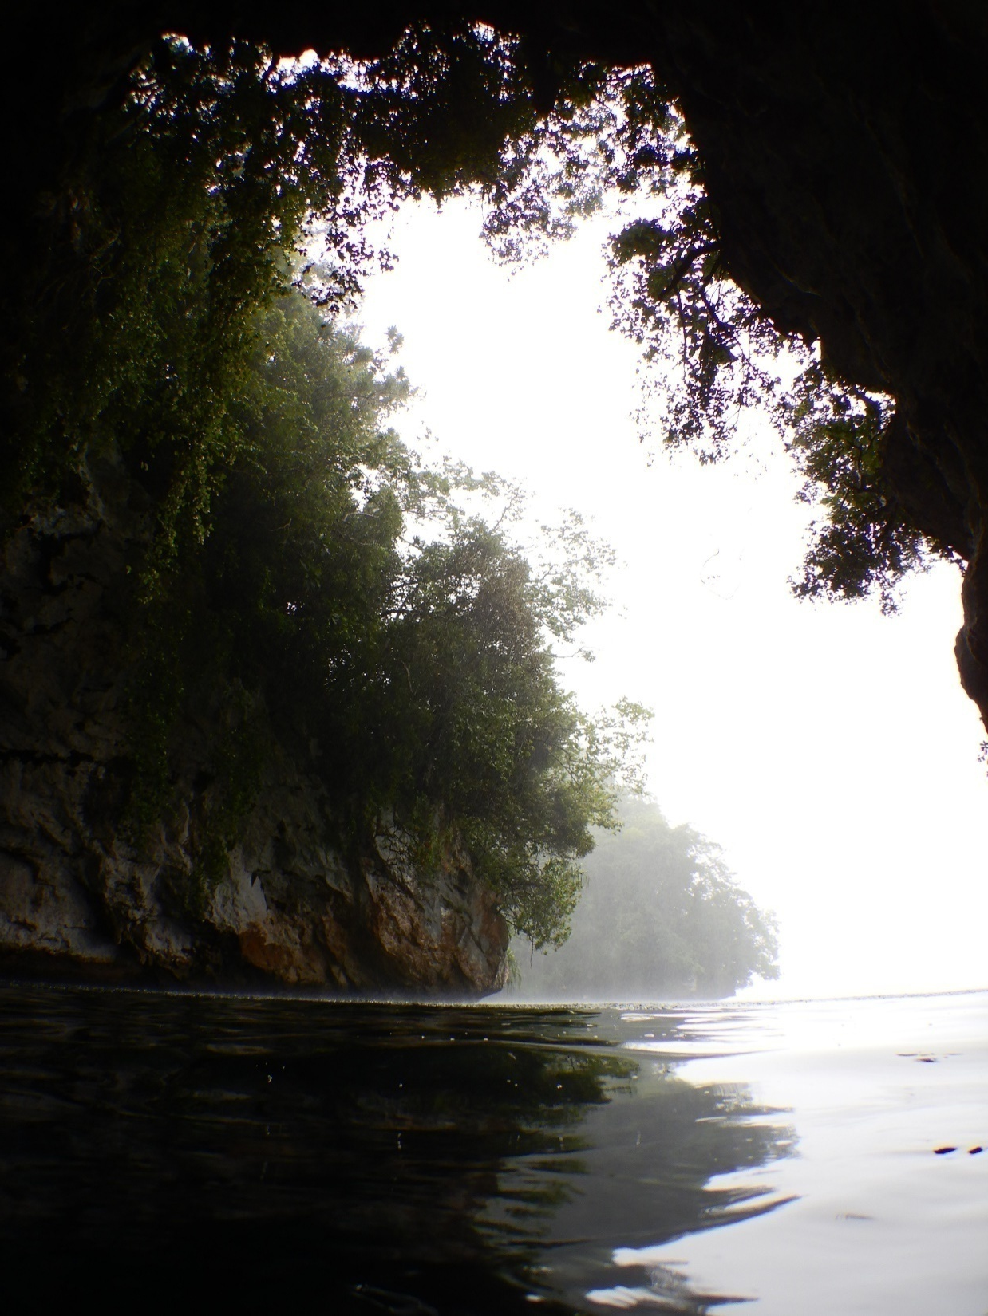
Contents of Presentation
Palau and Orientation/Compass
Weather & Climate in Palau Description
What kind of climate does Palau have?
What kind of weather is common in Palau?
Different weather stations in Palau
Define weather and variables measured
What is weather?
Air temperature
Wind speed and direction
Rain
Air pressure
Experiment
©2022 Coral Reef Research Foundation
Rain in the rock islands
Notes:
We have a few things to cover before we start the experiment.

Slide 3
Belau:
Tia ng ngarker?
Dimes me a lecub eng Diluches er a Beluulechad?
Helen Reef
©2022 Coral Reef Research Foundation
Notes:
If someone were to ask you, where is Palau? How would you answer? Is it in the southern or northern hemisphere?

Slide 4
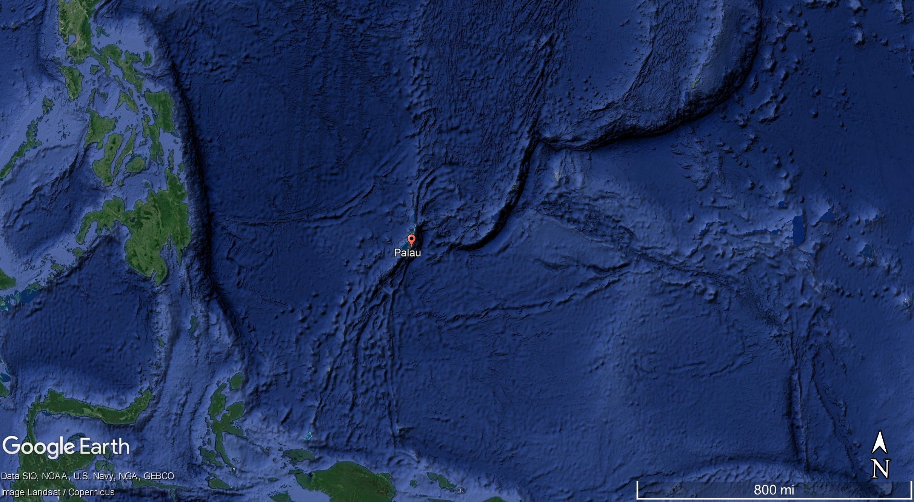
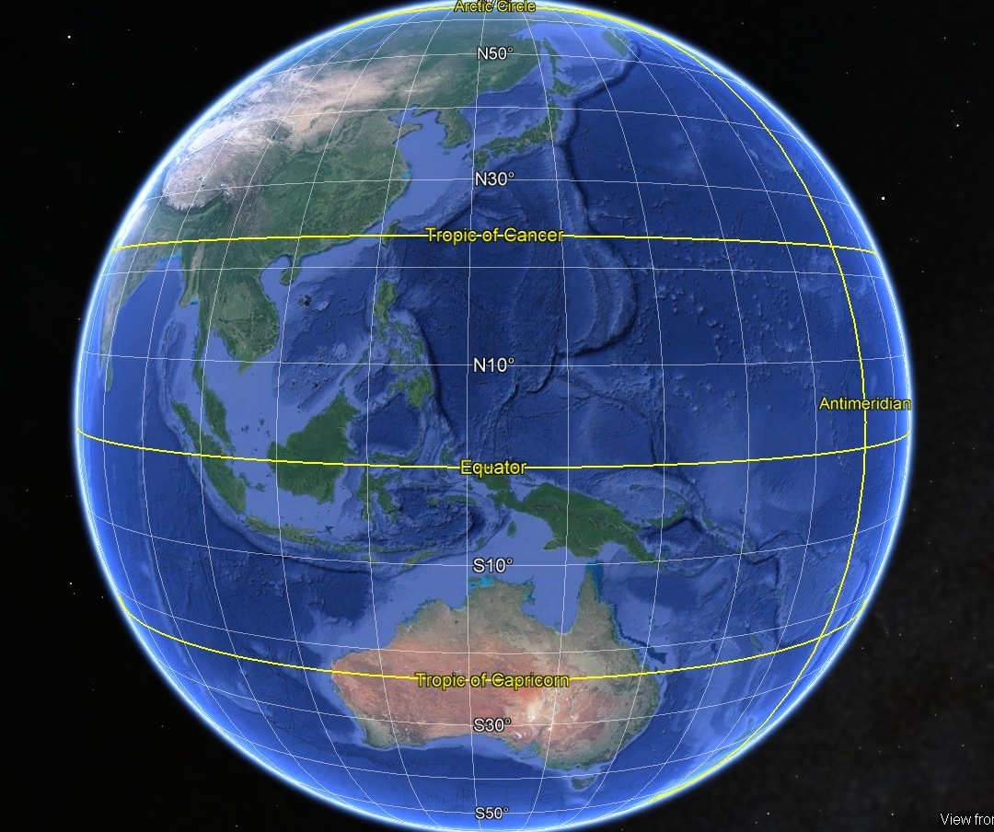
Beluu er Belau ng ngar er ker?
PHILIPPINES
YAP (FSM)
PALAU
INDONESIA
©2022 Coral Reef Research Foundation
Notes:
Palau is in the northern hemisphere, but it is located near the equator, in the western Pacific.

Slide 5
Beluu er Belau ng ngar er ker?
PHILIPPINES
YAP (FSM)
PALAU
INDONESIA
©2022 Coral Reef Research Foundation
Notes:
Palau is near Indonesia, Philippines and Yap. Palau’s location near the equator and Asia is important because it will help explain some of the weather patterns we observe in Palau.

Slide 6
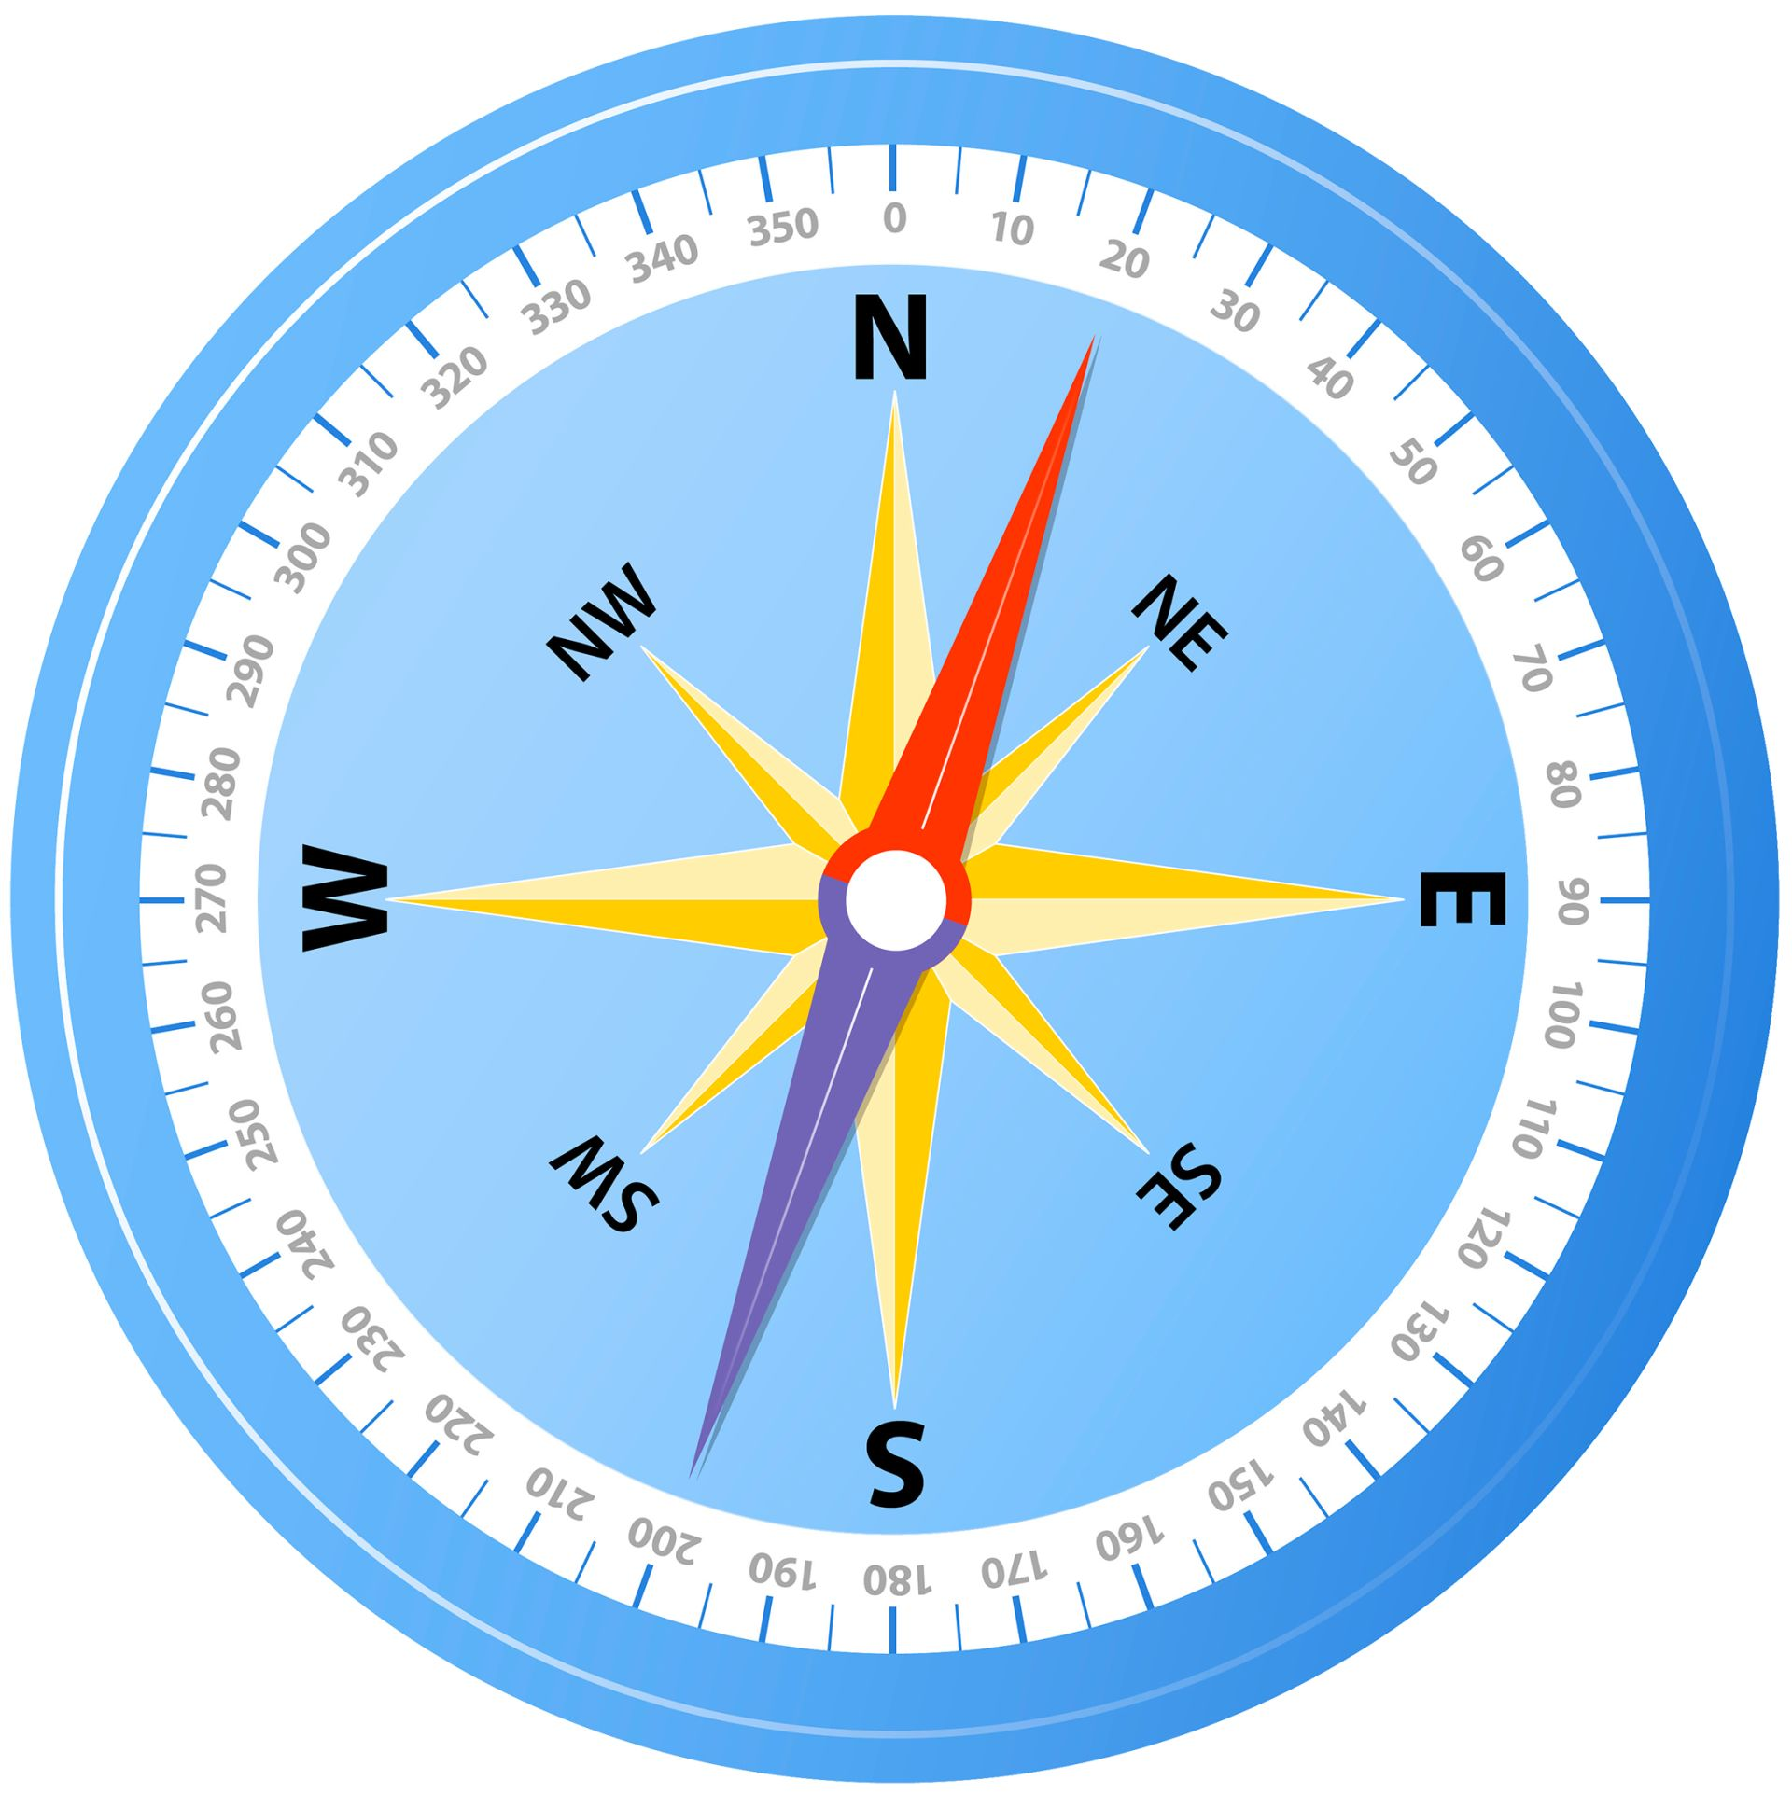
DILUCHES
Compass
ONGOS: NGESECHEL A SILS
NGEBARD: NGELTEL A SILS
NGEBARD
ONGOS
DIMES
©2022 Coral Reef Research Foundation
Notes:
Let’s cover compass direction, because it helps to understand weather patterns in Palau. How can you tell where East and West is? Sun rises on the east, sun sets on the west. To determine all directions, if it is in the morning, point your left hand to the sun (that is east, where the sun rises) and your right hand towards the west (where the sun sets). You are facing South, and your back is towards north North.

Slide 7
Beluu er Belau ng ngar er ker?
PHILIPPINES
YAP (FSM)
PALAU
INDONESIA
©2022 Coral Reef Research Foundation
Notes:
Let’s test your understanding:
Which country is south of Palau?→ Indonesia
Which country is northwest of Palau?→ Philippines
Which country is east of Palau? → FSM (Yap)

Slide 8
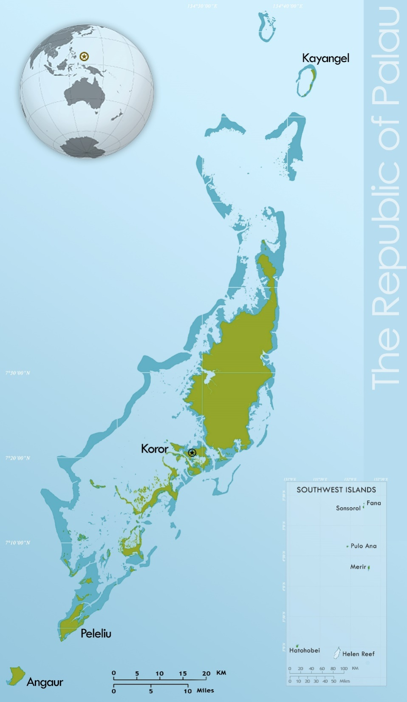
Archipelago
DILUCHES
Compass
NGEBARD
ONGOS
DIMES
©2022 Coral Reef Research Foundation
Notes:
What is northern most state of Palau? → Kayangel
The southern most state of Palau? → Hatohobei

Slide 9
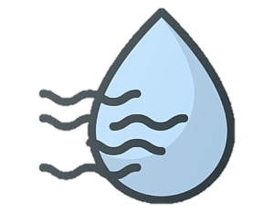
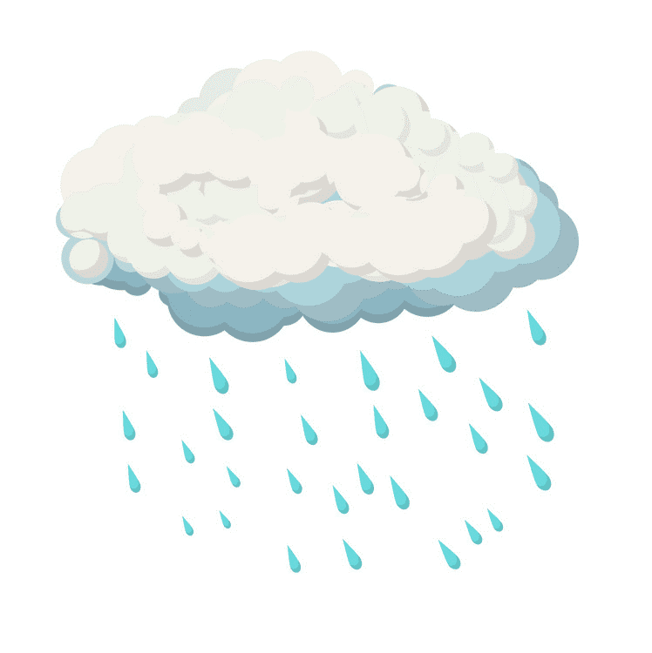
Palau: Tropical climate
ANNUAL AVERAGES
Hot: 28°C
Humid: 74–87%
Rain: 120–160 in
305–406 cm
Northeast Trade Winds: Oct–May
Southwest Monsoon Winds: June–Oct
©2022 Coral Reef Research Foundation
Notes:
The location of Palau near the equator puts Palau in a tropical climate zone. In this tropical climate zone, the weather is hot & humid. Average temperature is 28C, with high humidity of 74-87%. Palau does get a lot of rain, and there are two main seasons of wind – the trade winds and the monsoon winds.

Slide 10
Teletelel a eanged er Belau
Msodii a tetelel a eanged er elechang el sils.
©2022 Coral Reef Research Foundation
Notes:
Ask students to describe today’s weather.
Key things to look for is that student’s will identify temperature, cloudiness, wind, rain (if it is raining).
The weather can be different by the hour, the day or the year. Some days can be very hot, others cool. Some days can be calm, but sometimes we will get very strong winds during typhoons. How do we track our weather?

Slide 11
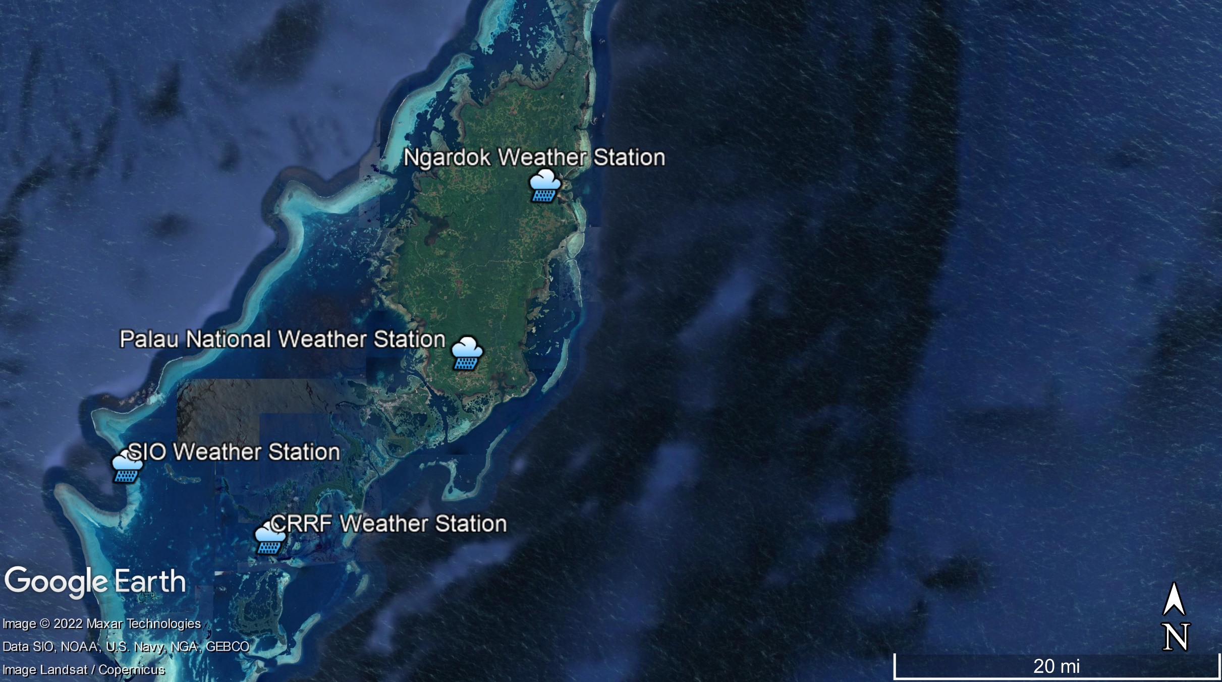
Mesil el meluk er a teletelel a eanged er a Belau
Coral Reef Research Foundation: Ngardok Lake, Melekeok, 2014
Palau National Weather Station: Airai, 2019; previously in Koror(1951–2019)
Scripps Institute of Oceanography (SIO): Ongingiang, Koror and Helen Reef, Tobi, 2012/13
Coral Reef Research Foundation: Ngeanges Island, Koror, 2007
©2022 Coral Reef Research Foundation
Notes:
People can track the weather using weather stations. In Palau, we have weather stations at different places. Palau’s National Weather Station is in Airai. It used to be in Koror, but they built a new one and moved to Airai in 2019. The National Weather Service office has been running since 1951. There are 2 weather stations run by CRRF, one in Ngardok Lake reserve in Melekeok and the other on Ngeanges Island in Koror. Scripps has different weather stations, one on Ongingiang, near Ulong, in Koror and another weather station at Helen Reef.

Slide 12
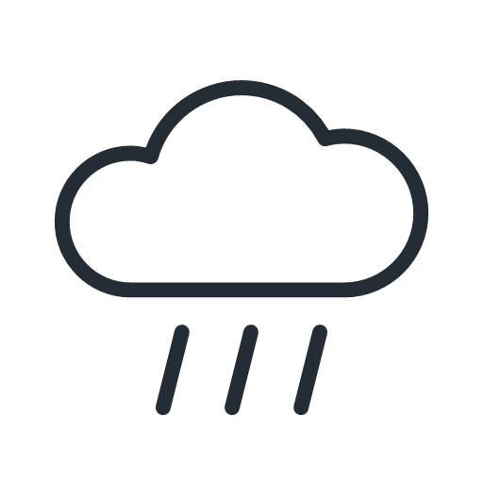
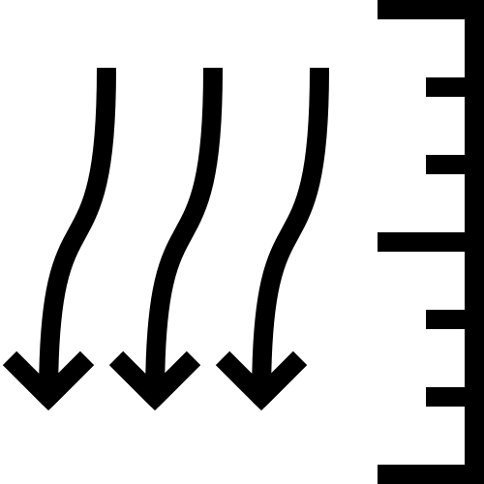
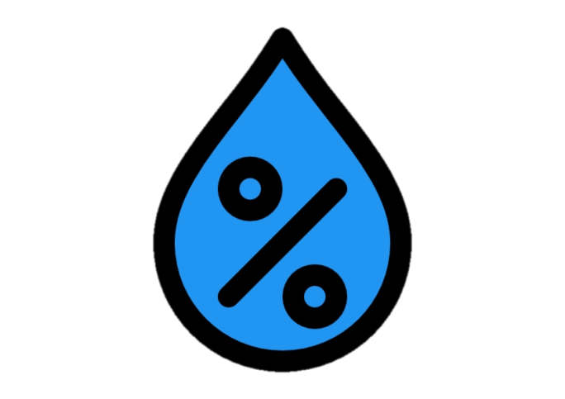
Omesodel a tetelel a Eanged
Eanged: blekerdelel a melidiul er a bek el sils luldimukl er a eolt er bebul a basio.
Kelekeltel/kleldelel a eolt & dekmekimes el eolt
Klisichel a eolt me a deruchellel
Chull
Berredel a eolt (air pressure)
©2022 Coral Reef Research Foundation
Notes:
What do these weather stations measure? They are measuring the daily state of the atmosphere, so they will measure air temperature, relative humidity, wind speed and direction, precipitation or rain and atmospheric or air pressure.

Slide 13
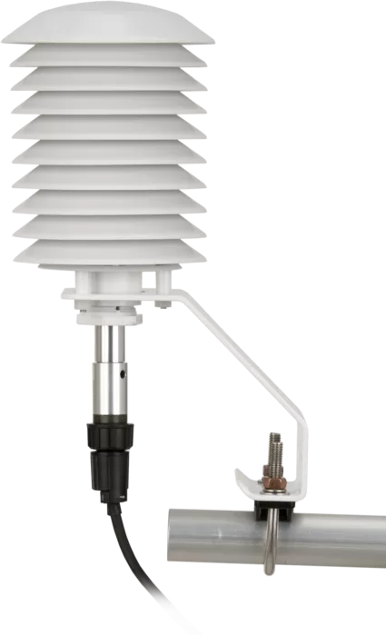
Omesodel a tetelel a eanged: Kelekeltel/kleldelel a eolt
Uangera kleldelel/kelekeltel a rikl
Mousbech er a Celsius/Fahrenheit el meluk
Mousbech er a thermometer el menguiu
Al ngar er bab = mekeald
Al ngar er eou = mekelekolt
A berredel a eolt er Belau a blechoel el osisiu er a bek el rak.
A eolt a blechoel el ngar er a 25-31 degrees Celsius a keleteltel/kleldelel.
Radiation shield
Wall thermometer
©2022 Coral Reef Research Foundation
Notes:
A common weather variable that is measured is air temperature. Air temperature tells you how warm or cold it is. Temperature is measured in Celsius and Fahrenheit, using thermometers. The higher the numbers, the warmer it is. So, 31 degrees Celsius is hot. The lower the number, the cooler it is. 25 degrees Celsius is cooler.
Air temperature in Palau does not change much throughout the year. It’s usually hot during the day, and cool at night.

Slide 14
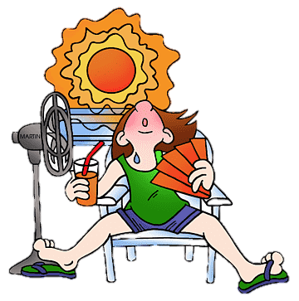
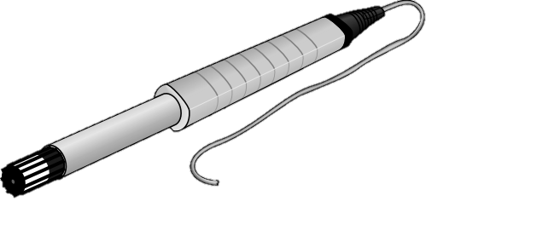
Weather Variables: Ralm er a Eolt
100%
Uncomfortably
Wet and Humid
Mesil meluk ra kelekolt/kleald a blechoel luldimukl er a mesil el kuk meluk er a klungel a ralm er a eolt
Klungel a ralm el ngar er a eolt
A loluk er ngii el ousbech er a percentage
100% saturation (dekimes), More than 60% (dekmekimes), 60% or less (medirt)
A eolt er Belau a dekmekimes e le ng remurt er a 77 el mor er a 84, eng di sebechel lemuut el kma el mo dekimes se el bol klou a chull
60%
Comfort Range
20%
Uncomfortably
Dry
Temp & RH sensor
0%
©2022 Coral Reef Research Foundation
Notes:
Usually a temperature sensor will come with a relative humidity sensor. This sensor measures how much water vapor is in the air, and it is reported as a percentage. 0% is dry, and 100% is saturation (or when it is raining). Anything higher than 60% is considered humid. Palau’s humidity is usually between 77 and 84%.
It can rain throughout the year, but some months like January–March are drier and some months like July–August are wetter than other months. For some years, there can be short periods of drought when Palau gets less than the usual amount of rain.
The winds switch between northeast trade winds and southwest monsoon winds during certain months of the year. From October–May, the winds are predominately northeastern trade winds. From June–October, winds will be southwest monsoon winds. Wind speeds are generally higher during the southwest monsoon months.

Slide 15
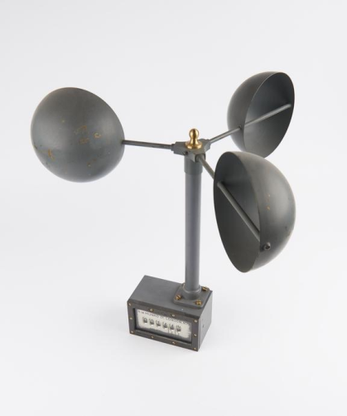
Weather Variables: Eolt
Omerollel a eolt er bebul a Beluulechad
A mekeald el eolt sel bor er bab, me a mekelekolt el eolt meng merael el mor er bab el mo er se el blar er ngii a mekeald el eolt.
Teblong el teletelel a doluk er a eolt: Klisichel me a deruchellel
Klisichell a eolt a ochotii a rretel a eolt.
Rretel a eolt a sebechel el mph, m/s me a lechub eng knots. Lebo er bab a lambang eng mesisiich a eolt.
Kede meluk er a klisichel a eolt el obang a dongu el anemometer
Kellechakl
<1 knots, mph
<0.3 m/s
Mechecheluut
7-10 knots
8-12 mph
3.3-5.5 m/s
Meses a eolt
22-27 knots
25-30 mph
10.8-13.9 m/s
Mesisiich el eolt
48-55 knots
55-63 mph
24.5-28.4 m/s
The numbers show the strength of the winds in the different units.
Anemometer
©2022 Coral Reef Research Foundation
Notes:
Wind is the movement of air across the Earth’s surface. Air will move because of differences in temperature. Warm air rises, and cool air moves in and replaces the rising warm air. Meteorologists make two measures for wind – speed and direction. Wind speed is how fast or strong the wind is. It is usually in m/s, knots or mph. The higher the numbers, the stronger the wind.

Slide 16
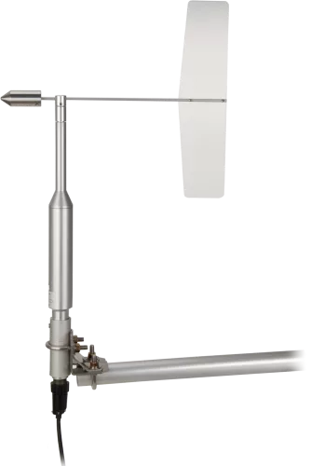
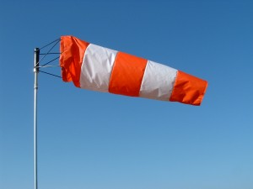
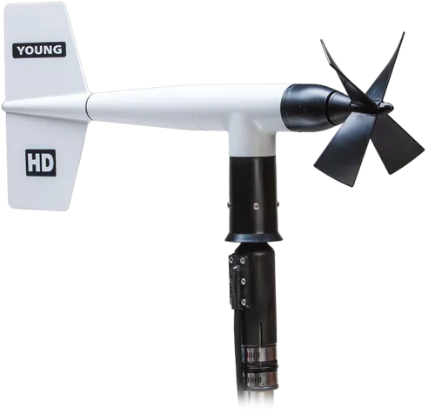
Weather Variables: Wind
Deruchellel a eolt a ochotii kmo ngarker el mei.
Eolt er Ongos a ngar er a Ongos el merael mor er a Ngebard.
Deruchellel a eolt a doluk er ngii lolab a keldei el dongu: wind vane, flags and wind socks.
Wind sock
Wind Vane
Wind monitor (combined)
©2022 Coral Reef Research Foundation
Notes:
Wind direction is the direction that the wind blows from. An easterly wind is wind blowing from the east to the west. Wind Direction can be measured using weather vanes, flags and windsocks.

Slide 17
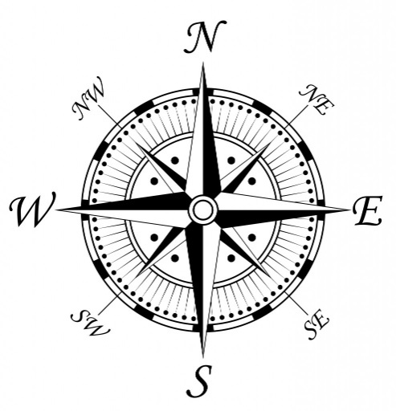
Wind Direction: Trade Winds (October – May)
NE
©2022 Coral Reef Research Foundation
Notes:
Again the location of Palau is key here. Palau is located near the equator, and trade winds occur near the equator. So, most of the year (October–May), we have trade winds that blow in from the north east in Palau.

Slide 18
Wind Direction: Monsoon (June–October)
SW
©2022 Coral Reef Research Foundation
Notes:
Palau location is near Asia where there are monsoon seasons. There are times during the year, usually June–October, when Palau has monsoon winds that blow from the southwest.

Slide 19
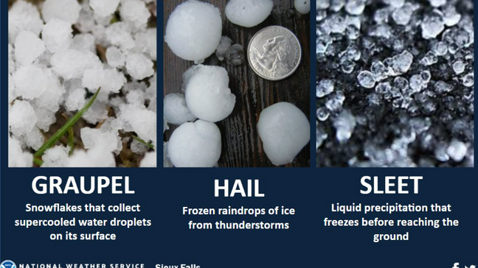
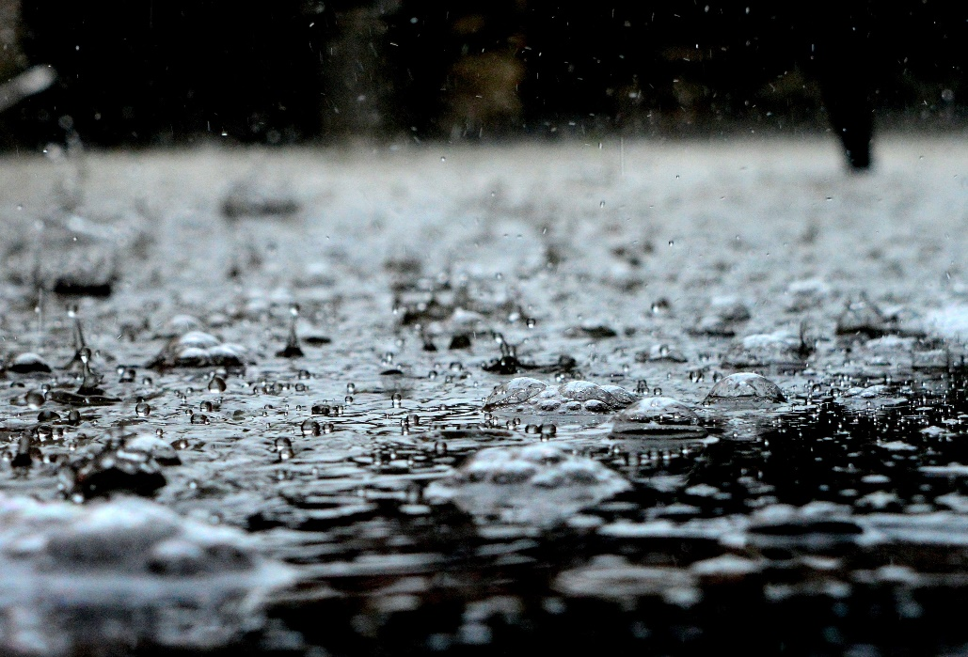
Weather Variables: Precipitation
Ralm me a lechub eng kori el obeob er a melidiul e ruebet el mei er a Beluulechad.
RAIN
©2022 Coral Reef Research Foundation
Notes:
Precipitation is any water that forms in the atmosphere and falls back to the Earth. It can be liquid like rain or frozen like graupel, hail and sleet.

Slide 20
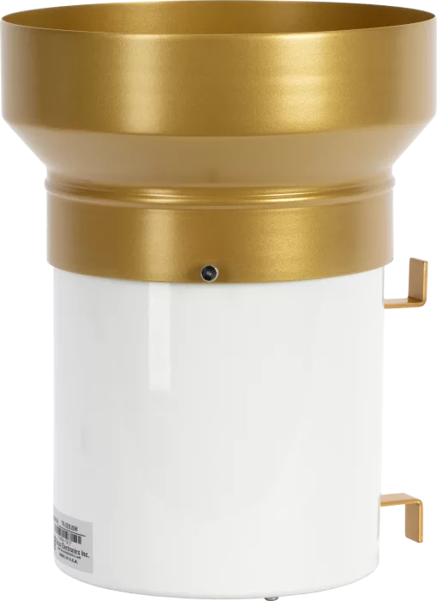
Weather Variables: Precipitation
Belau a mekeald meng di tal chull e merkong
Kede meluk er a chull el obang a tipping buckets
Klou a chull er Belau di bebil er a taem eng ma el mo medirt
Buil el klou
A chull:
June–August (monsoon season)
Buil el telkib
a chull:
January–April
Tipping bucket
Chull
©2022 Coral Reef Research Foundation
Notes:
In Palau, we have only rain, and no sleet, snow or graupel. We can measure rain with tipping buckets. It rains a lot in Palau, but some months are drier and some months have more rain than others. Dry months are usually from January to April, and between June and August is generally the highest rainfall of the year.

Slide 21
Weather Variables: Atmospheric Pressure
Berredel a eolt er a bebul a ulterkokl el basio.
Kede meluk er ngii lobang a barometer.
Barometers a dousbech omes er a eanged er a chelsel a kedeb el taem.
Warm Air
Cold Air
HIGH
LOW
Barometer
©2022 Coral Reef Research Foundation
Notes:
Atmospheric pressure is the weight of air above a given area, and it is measured using a barometer. Air pressure changes can be used to predict short-term changes in the weather. On warm, sunny days air pressure is high. When a storm or bad weather is approaching, air pressure is low.

Slide 22
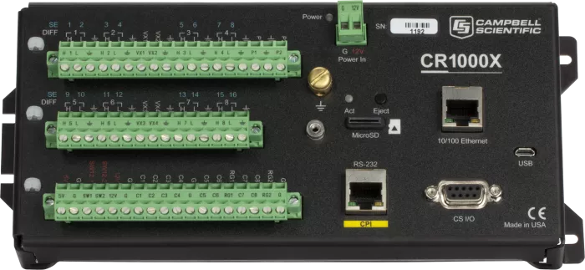
Weather Station Data Logger & Communications
Mesil a dongetiut er a data logger.
Data logger a ouchais er a bek el mesil kmo oingerang eng menguiu.
Data logger a ngmai aike el longuiu a mesil e oreked.
©2022 Coral Reef Research Foundation
Notes:
All the weather station sensors are connected to a data logger that sends instructions about when and what to measure. The loggers also store data.

Slide 23
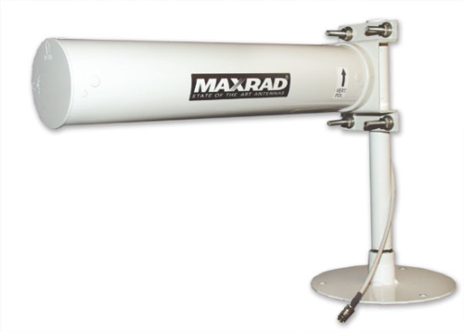
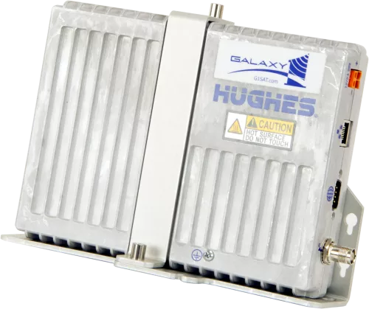
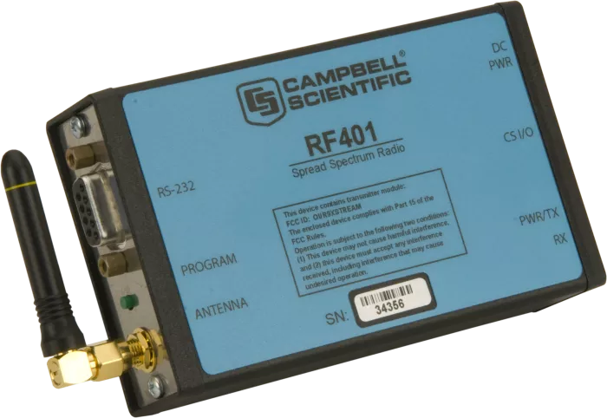
Weather Station Data Logger & Communications
Download data through radio or satellite.
Radio Communications
Satellite Communications
©2022 Coral Reef Research Foundation
Notes:
Picture of radio antenna and satellite modem.

Slide 24
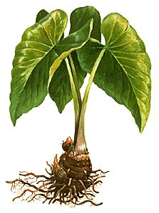
Ngera mekede mesuub er a tetelel a eanged?
Ng klou a ultutelel el merkid er a bek el sils.
A tetelel a eanged a blechoel ngodech.
E se el bol ngodech eng dirrek el ngodechii a
tetelel a klengar er kid.
Omenged, sers
Tekoi er a ukeruul
Meruul ongdibel
Omlaoch er a tetelel a eanged
Omesubel a ngedechel a eanged
Bebil er a tetelel a omesuub
©2022 Coral Reef Research Foundation
Notes:
Weather can affect where and when we fish. If it is windy on the east side of Palau, we fish on the west side. Rainy days can affect when we can plant. Weather can affect public health - rainy days can lead to more mosquitos and a rise in dengue. We study the weather to make predictions and to help in planning events. We also study how the weather patterns are changing because of climate change.

Slide 25
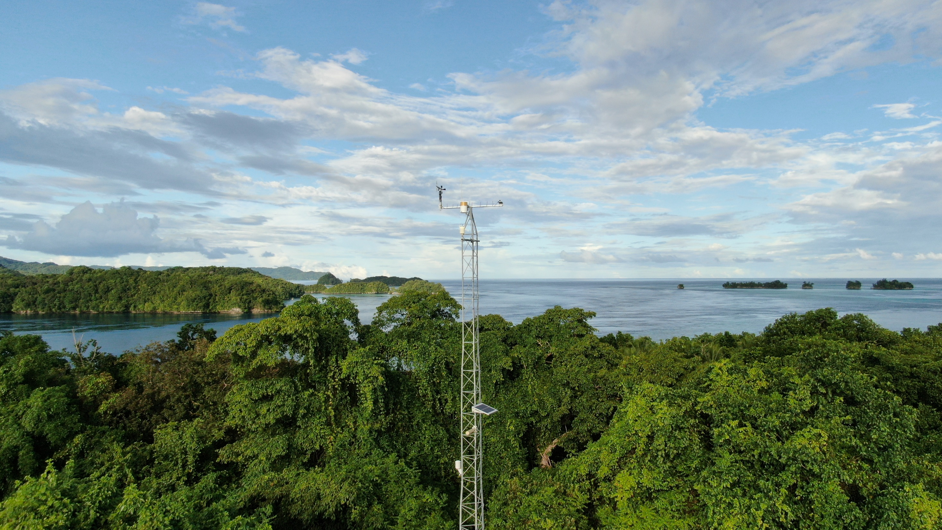
Coral Reef Research Foundation Weather Station
https://weather.coralreefpalau.org/
Updated every hour
Past days (daily, monthly, yearly)
©2022 Coral Reef Research Foundation
Notes:
You can look at weather information online at the Coral Reef Research Foundation website. The website is updated every hour. You can view daily, monthly and yearly data.

Slide 26
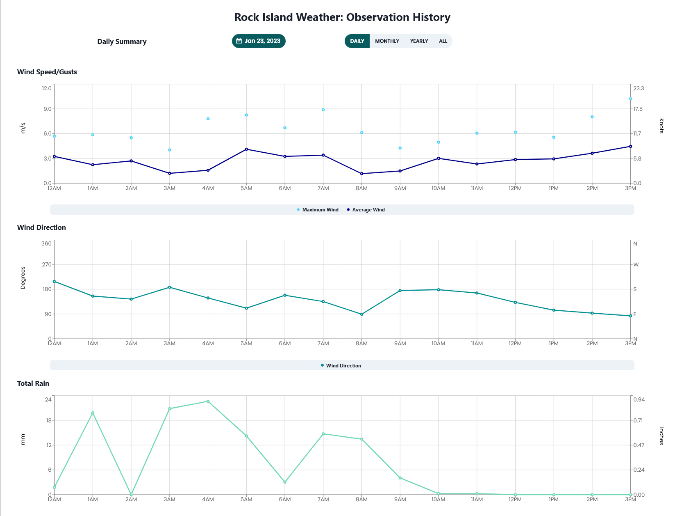
©2022 Coral Reef Research Foundation

Slide 27
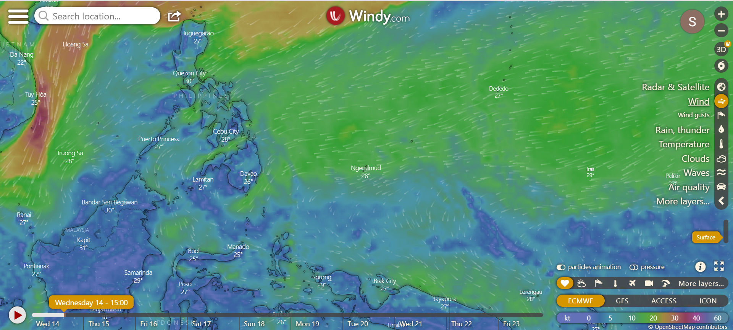
Windy.com: Weather forecast
https://www.windy.com/?7.695,134.626,5
©2022 Coral Reef Research Foundation
Notes:
Click on Ngerulmud.

Slide 28
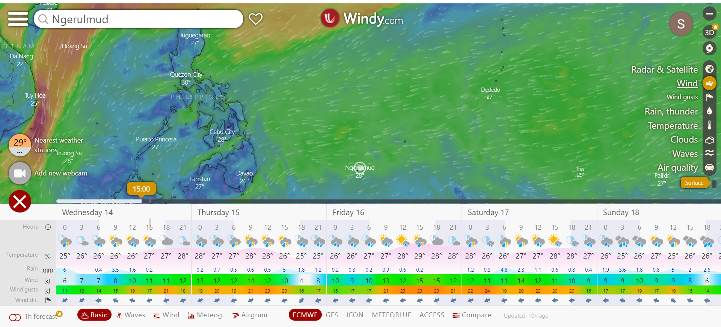
©2022 Coral Reef Research Foundation
Notes:
Table shows from top to bottom: hours during the day, sky condition, air temperature, rain, wind, wind gusts and wind direction. These are forecasts for up to 10 days.

Slide 29
Experiment
Rengalek er a skuul a mo omes a video e di tir el meruul a mesil er tir el meluk er a tetelel a eanged.
Te mo obii el mo er a group ea tang el group a meruul er a chimong el mesil.
Chelsel a tang el sandei te mo meluk er a tetelel a eanged er a bek el tutau.
Se el ulebengelel a tang el sandei te mo graph e smaod a urerir el mo er a rebek el chad.
Videos & instructions:
Rain gauge
Wind anemometer
Wind vane
Barometer
©2022 Coral Reef Research Foundation

